Slide 1
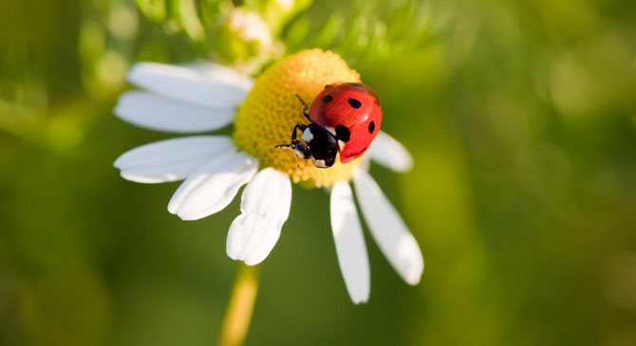
Sexual reproduction in plants

Slide 2
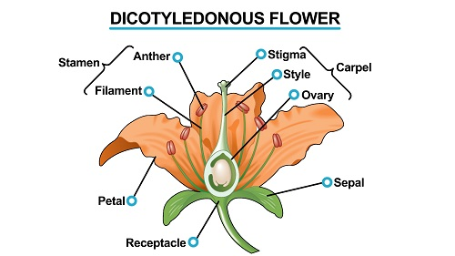
Structure of an insect-pollinated dicotyledonous plant

Slide 3
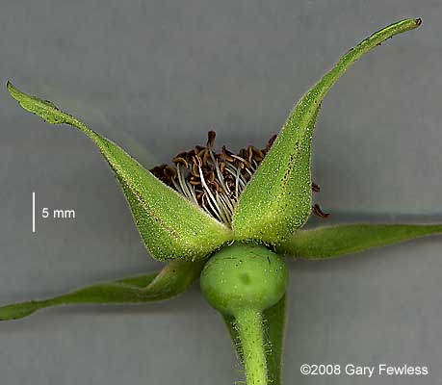
Sepals
Sepals cover the flower structure while the flower is developing. In some species these are modified to 'petals'.
They are usually green and protect the flower in bud. The collective name for the sepals is calyx.

Slide 4
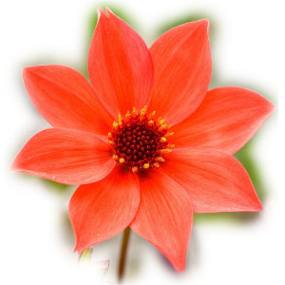
Petals
Petals surround the male and female flower parts.
Their function is to attract animal pollinators – they are usually brightly coloured and have a scent. They may also produce nectar.

Slide 5
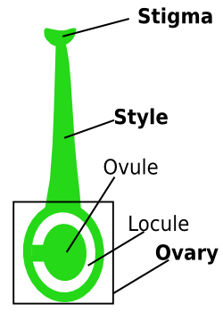
The Carpel
The carpel is made up of 3 parts:
Stigma
Style
Ovary

Slide 6
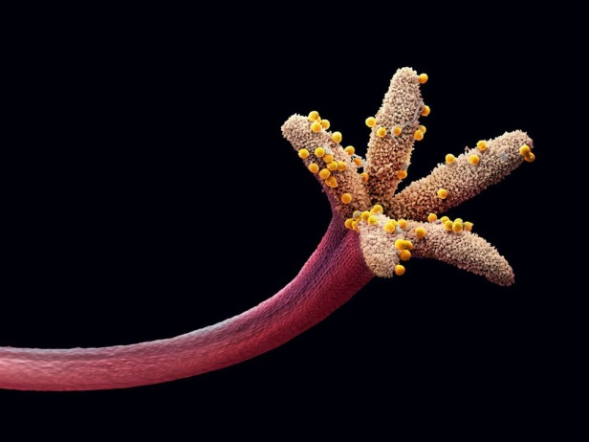
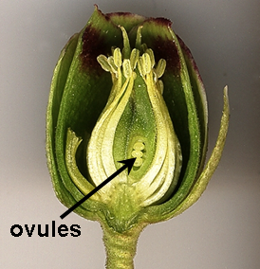
The Carpel
The stigma is the surface on which pollen lands and the pollen tube grows down to the ovary.
The style connects the stigma to the ovary.
The ovary contains the ovules (contain single egg nuclei).

Slide 7
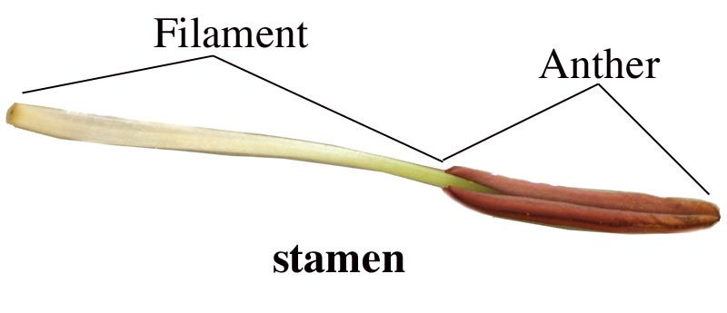
The Stamen
The stamen is made up of 2 parts:
Anther
Filament

Slide 8
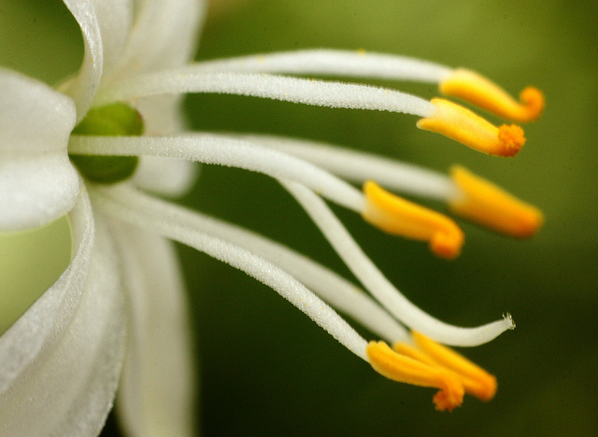
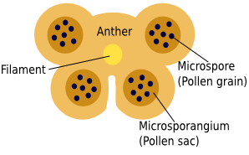
The Stamen
Filaments support the anthers that produce the pollen grains.
The filaments also contain vascular tissue which transports the food materials required for the formation of pollen grains.
The anthers are usually made up of four pollen sacs arranged in two pairs.

Slide 9
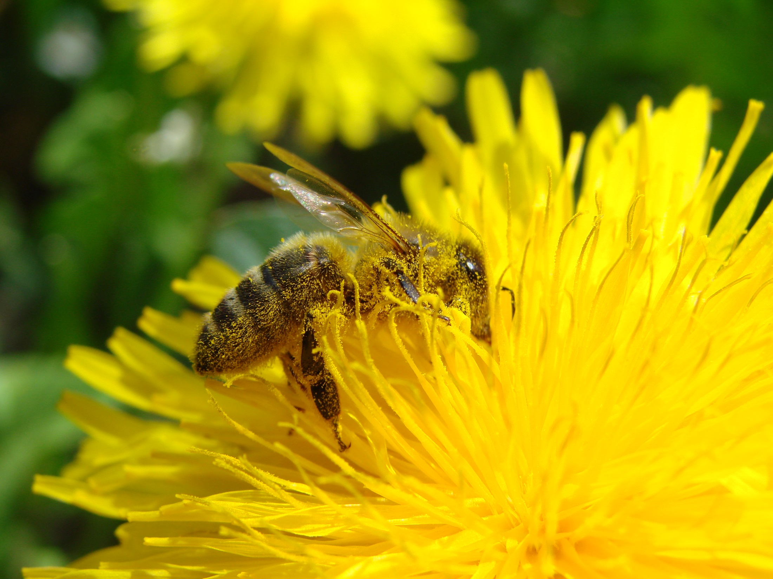
Pollination

Slide 10
Methods of pollination
Pollination is the transfer of pollen from anthers to stigmas.
If the transfer occurs between two plants of different genetic make-up i.e. another plant of the same species the process is cross-pollination.
If the transfer takes place between flowers of identical genetic constitution, the process is self-pollination.

Slide 11
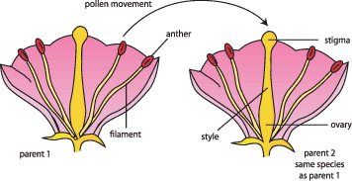
Cross pollination

Slide 12
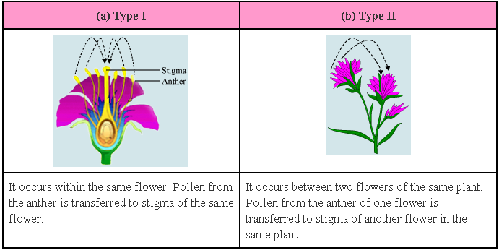
Self pollination

Slide 13
Insect vs wind pollination
Insect-pollinated flowers | Wind-pollinated flowers
Conspicuous flowers with large brightly coloured petals | Inconspicuous flowers with small drab (green or brown) petals or no petals
Scented | Not scented
Nectaries present | Nectaries absent
Relatively low pollen production (pollen is sticky) | Very high pollen production
Stamens enclosed in flower so that insect brushes past them | Stamens pendulous (hang outside the flower)
Stigmas relatively small and sticky | Stigmas large, feathery, and hang outside the flower
Pollen relatively large and often spiny | Pollen small, light and usually smooth
Plants often single or in small groups | Plants often in dense groups covering a large area
Very complex structural modifications to attract insects | Relatively simple flower

Slide 14
The genetic consequences of self- and cross-pollination
While self-pollination is an advantage to a plant if there are no similar plants nearby, it results in in-breeding. This leads to a reduction in the gene pool and therefore reduces variation in the population.
Self-pollinated species depend on random assortment and crossing over during meiosis, and on mutation, to bring about variation in the genomes of male and female gametes. Therefore self-fertilised species display less genetic variation than cross-fertilised species.

Slide 15
Cross pollination
Cross-pollination has the advantage of providing more genetic variation. Mechanisms favouring cross-pollination include:
Having separate male and female plants (e.g. willow)
Having separate male and female flowers on one plant (e.g. hazel)
Anthers and stigmas maturing at different times (e.g. bluebell)
Structural adaptations which make self-pollination unlikely e.g. in primroses the anthers and stigmas are arranged at different levels on the flower so that cross-pollination between pin-eyed and thrum-eyed flowers is favoured.

Slide 16
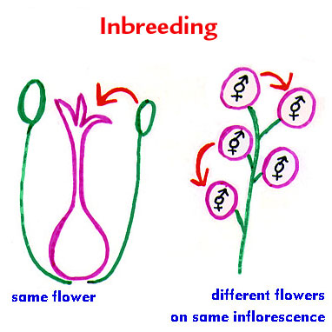
In-breeding
While out-breeding is of greater evolutionary significance due to the fact that some genomes are more successful than others in the struggle for survival, there are advantages to in-breeding e.g. it preserves good genomes which may be suited to a relatively stable environment.

