Slide 1
Collect results from the germination experiment (5 minutes)
Your homework (write it down) is to present the results in a table and a graph

Slide 2
5 Question Quiz No cheating
http://www.proprofs.com/quiz-school/story.php?title=simple-diffusion-quiz

Slide 3
Diffusion game
http://www.best1000games.com/diffusion/

Slide 4
Objectives
Investigate the effect of concentration on rate of diffusion
I understand why simple, unicellular organisms can rely on diffusion for movement of substances in and out of the cell
I understand the need for a transport system in multicellular organisms

Slide 5
Why are cells so small?

Slide 6
Agar diffusion practical.

Slide 7
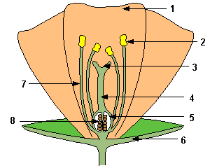
Quick test on parts of flower!!!!

Slide 8
Intro:
http://www.youtube.com/watch?v=w6f2BiFiXiM&feature=related

Slide 9
HW answers
Insect Pollinated | Wind Pollinated
stigma has sticky coating - pollen sticks to it | anthers firm and inside flower - to brush against insects
small petals, often brown or dull green - no need to attract insects | large, brightly coloured petals - to attract insects
no nectar - no need to attract insects | usually contain nectar - to attract insects
anthers loosely attached and dangle out - to release pollen into the wind | no scent - no need to attract insects
pollen often sticky or spiky - to stick to insects | pollen very light and smooth - so it can be blown in the wind and stops it clumping together
stigma inside the flower - so that the insect brushes against it | stigma feathery or net like - to catch the drifting pollen
moderate quantity of pollen - less wastage than with wind pollination | stigma hangs outside the flower - to catch the drifting pollen
pollen produced in great quantities - because most does not reach another flower | often sweetly scented - to attract insects

Slide 10
Objectives I should be able to…
2.51 describe the role of phloem in transporting sucrose and amino acids between the leaves and other parts of the plant
2.52 describe the role of xylem in transporting water and mineral salts from the roots to other parts of the plant
2.53 explain how water is absorbed by root hair cells
2.54 understand that transpiration is the evaporation of water from the surface of a plant

Slide 11
Circus activity

Slide 12
1 | These tubes carry water and mineral salts up the stem. (page 202) | ... xylem.
2 | These tubes carry dissolved food from the leaves to the rest of the plant. (p. 202) | ... phloem.
3 | Where is the xylem and phloem found in a stem? (p. 203) | ... in a ring of vascular bundles.
4 | What is cambium? (p. 203) | ... a layer of cells that divides to form new xylem and new phloem.
5 | How would you prove that water passes up the xylem tissue? (p. 203) | ... stand a plant in dyed water for a few hours. Then cut a section of the stem and find out where the dye is located.
6 | How are root hairs adapted for absorbing water? (p. 204) | ... they have thin cell walls and a large surface area.
7 | What do we call the evaporation of water from the leaves into the air? (p. 205) | ... transpiration.

Slide 13
8 | What do we call the continuous flow of water from the roots up to the leaves in the xylem? (p. 205) | ... the transpiration stream.
9 | What happens to young plants if they lose too much water by transpiration? (p. 206) | ... they wilt.
10 | What conditions cause the rate of transpiration to increase? (p. 206) | ... windy, dry, warm conditions.
11 | What conditions cause the rate of transpiration to decrease? (p. 206) | ... still, humid, cool conditions.
12 | What does a potometer measure? (p. 207) | ... the rate of water uptake.
13 | What could you do to a potometer to make conditions a) windy? and b) humid? (p. 207) | ... a) put the potometer near a fan b) put a polythene bag over the shoot.
14 | Some salts enter roots by diffusion but others are taken up by . . . (p. 208) | ... active transport.
15 | What is translocation? (p. 208) | ... the movement of soluble food around the plant in the phloem.

Slide 14
carries food to growing parts and storage organs | made of dead cells
carries water and minerals to the leaves | made of living cells
cell wall made of cellulose | no cytoplasm
cell wall made of lignin | permeable cell walls
cells are lined with cytoplasm strands | thick cell wall
cross walls are absent | thin cell wall
flow is up and down | tissue also contains fibres
flow is upward | tissue also has companion cells
has perforated cross walls | transports food
impermeable cell walls | transports water and minerals

Slide 15
XYLEM | PHLOEM
made of dead cells | made of living cells
thick cell wall | thin cell wall
cell wall made of lignin | cell wall made of cellulose
impermeable cell walls | permeable cell walls
cross walls are absent | has perforated cross walls
no cytoplasm | cells are line dwith cytoplasm strands
transports water and minerals | transports food
carries water and minerals to the leaves | carries food to growing parts and storage organs
flow is upward | flow is up and down
tissue also contains fibres | tissue also has companion cells

Slide 16
http://www.bbc.co.uk/learningzone/clips/plant-adaptations-to-overcome-environmental-limitions/12901.html

Slide 17
I should be able to…
Grade B
Describe transpiration as the evaporation of water from the surface of a plant
Grade A
Explain how the rate of transpiration is affected by changes in humidity, wind speed, temperature and light intensity

Slide 18
Water enters the plant via the roots. The roots are adapted for this role by having cells with hair-like protrusions (root hair cells) which increases the surface area.
Water enters the root by osmosis and moves along through the root cells in the same way until it gets to the xylem vessels. These vessels carry water up the stem to the leaf.
Water is lost from the leaves of plants by evaporation. This is known as transpiration. Most of the water lost by a plant occurs through the tiny pores in the leaf called stomata. These pores open during the day to allow gaseous exchange for photosynthesis. In doing so they also allow water to be lost by evaporation from the cells of the leaf.
Water is drawn from the xylem vessels in the veins of the leaf by osmosis to replace the water lost. This drawing of water from the xylem vessels causes water to be pulled up the xylem vessels of the stem from the roots.
The xylem vessels themselves are very thin tubes, like capillary tubes. They have very hard and waterproof walls. The cells which made the xylem vessels died to produce a continuous column or tube.

Slide 19
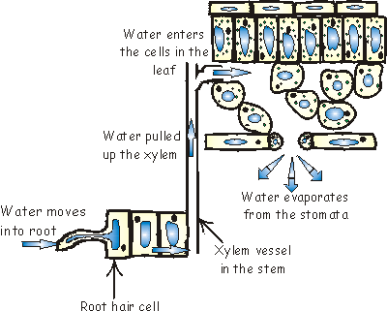

Slide 20
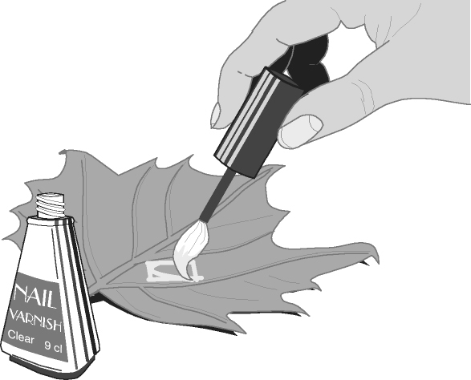
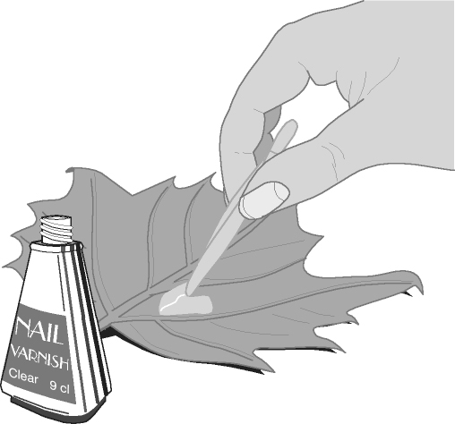
Nail varnish!!!
Paint a small area of the underside of a leaf with clear nail varnish.
When it is dry gently peel it off using selotape and look at it under the microscope.

Slide 21
http://www.mhhe.com/biosci/genbio/virtual_labs/BL_10/BL_10.html

Slide 22
Adaptations of palisade cells and stomata
____________ are adapted to their function as they contain lots of ____________ and are close to the ______of the leaf. This means lots of light can be _________. Chloroplasts can _______ to the top of the cell to absorb even more light.
________are holes in the bottom of the leaf. They are opened and closed by _________. __________ enters in the _____ and is used in photosynthesis. ______ and _______ are lost through the stomata. The leaf is ______ to the carbon dioxide does not have far to _______.
chloroplasts, carbon dioxide, water, stomata, oxygen, diffuse, top, absorbed, guard cells, thin, move, palisade cells, day

