Slide 1
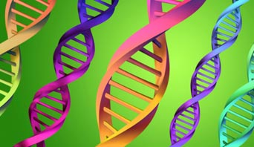
Inheritance

Slide 2
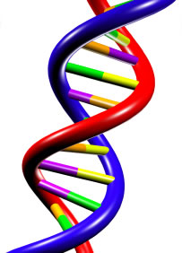
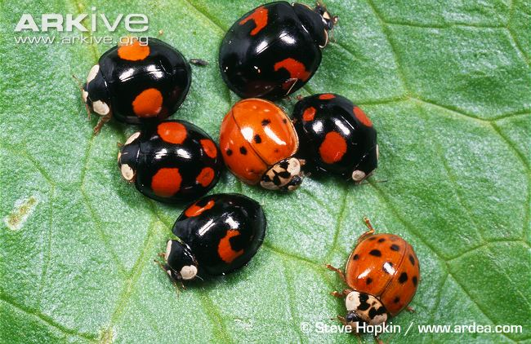
Genetic terms
Genetics and heredity is a study of the means by which DNA is transmitted from generation to generation.
Observation of individuals of the same species shows them to be recognisably similar. This is heredity.
Closer inspection reveals minor differences. This is variation.

Slide 3
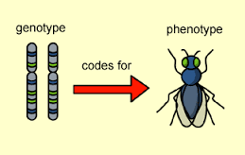
Genotype
The genetic composition of an organism is called the genotype. This often sets limits within which individual characteristics can vary.
Such variation may be due to the effect of environmental influences e.g. the genotype may determine a light-coloured skin, but the precise colour of any part of the skin will depend upon the extent to which it is exposed to sunlight.
Any change in the genotype is called a mutation and may be inherited.

Slide 4
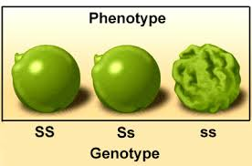
Phenotype
The phenotype, or set of characteristics, of an individual is therefore determined by the interaction between the genotype and the environment.
Any change to the phenotype only is called a modification and is not inherited.

Slide 5
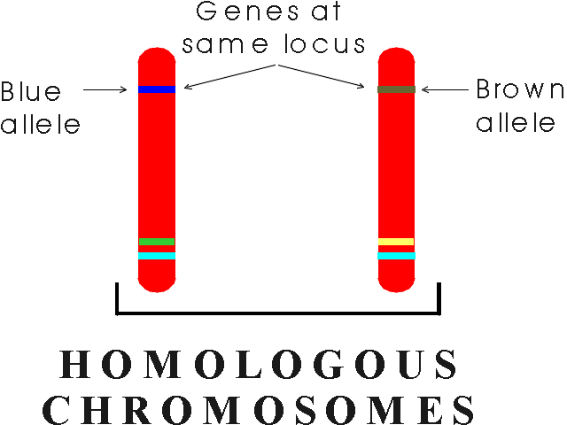
Alleles
A diploid organism has two sets of chromosomes and two forms (alleles) of each particular gene.
These alleles may be the same (the organism is homozygous for that gene) or different (the organism is heterozygous for that gene).

Slide 6
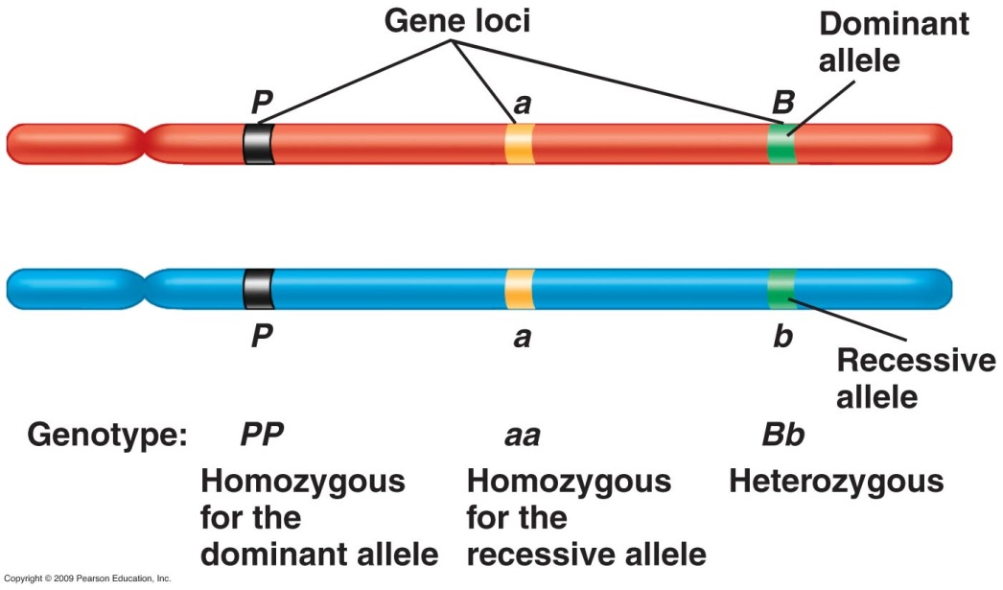
Dominance
If different, one of the alleles (the dominant allele) may mask the other allele (the recessive allele). The dominant allele is therefore expressed in either the heterozygous condition or the homozygous condition, whereas the recessive allele is only expressed in the homozygous condition.

Slide 7
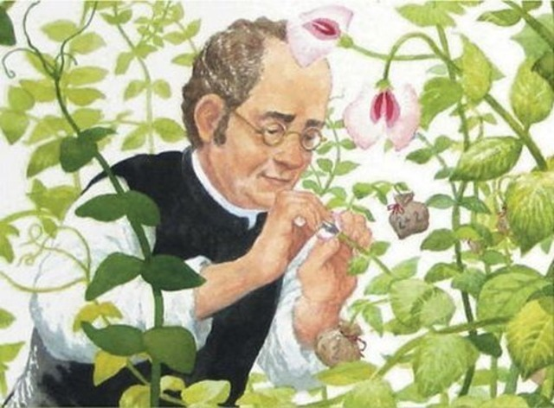
Mendelian Inheritance

Slide 8
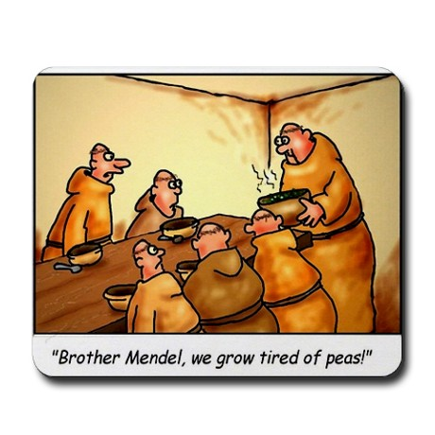
Gregor Mendel
Gregor Mendel studied the process of heredity in selected features of the garden pea Pisum sativum.
He chose peas because they were easy to grow, they had a short life cycle, their pollination could be controlled and they had easily observable characteristics.

Slide 9
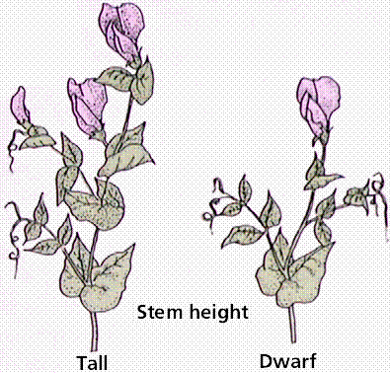
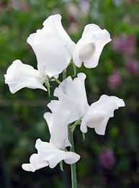
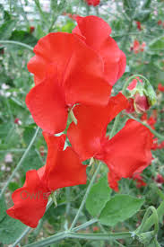
Mendel’s work
Mendel isolated pea plants which were pure-breeding e.g. when they bred with each other they produced consistently the same characteristics over many generations.
He referred to each character as a trait. He chose traits which had two contrasting features e.g. he chose stem length, which could either be long or short and flower colour which could be red or white.

Slide 10
Mendel’s work
Mendel then selected for his experiments two pure-breeding plants with alternative expressions of a particular characteristic e.g. a tall and dwarf plant.
He crossed the plants by transferring pollen from the male parent to the stigma of the female parent.

Slide 11
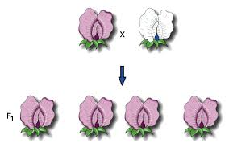
Mendel’s work
Mendel collected the seeds produced by the female parent and grew them the next year to give the first generation offspring (the first filial generation or the F₁).
He carefully recorded the characteristics of these plants and then crossed two plants from this generation. This type of cross involving plants form the same generation is called a self-cross.

Slide 12
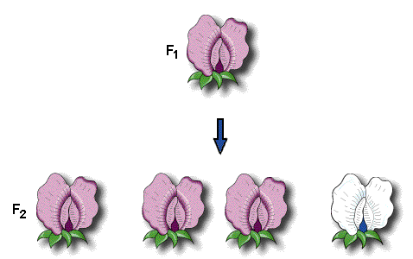
Mendel’s work
Again the seeds produced were collected and grown the following year to give the second generation of offspring (the offspring produced by a cross between F₁ parents is often called the second filial generation, or the F₂).

Slide 13
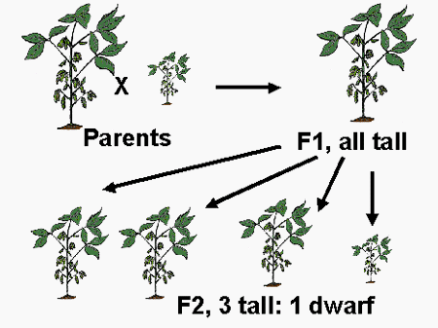
Mendel’s findings
The results of Mendel’s experiments showed that the F₂ plants were a mixture of tall and dwarf plants in the approximate ration of 3:1. Similar crosses involving other single characteristics produced similar results, all producing an approximate ratio of 3:1 in the F₂.
The most striking features of the results were that:
There were no plants of intermediate height
There were no dwarf plants in the F₁ generation, though they reappeared in the F₂

Slide 14
Mendel’s conclusions
Mendel used these findings to develop his first law of inheritance, the Law of Segregation, which states that:
‘The characteristics of an organism are determined by internal factors (alleles) which occur in pairs. Only one of each pair of factors (alleles) can be represented in a single gamete’
Mendel’s breeding experiments with tall and dwarf plants are an example of monohybrid inheritance: that is, inheritance involving a single characteristic determined by one gene.

Slide 15
The monohybrid cross - terminology
The use of ‘F₁ generation’ should be limited to the offspring of homozygous parents. Similarly, ‘F₂ generation’ should refer only to the offspring of the F₁ generation. In all other cases ‘offspring (1)’ and ‘offspring (2)’ should be used.
The complete set of headings for a genetic cross, in order, is:
Parents: phenotypes
Parents: genotypes
Gametes
Offspring (1) genotypes
Offspring (1) phenotypes
Gametes
Offspring (2) genotypes
Offspring (2) phenotypes

Slide 16
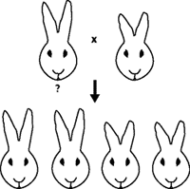
The test cross
An organism which shows a dominant character can have two possible genotypes e.g. purple plants could either be homozygous dominant (PP) or heterozygous (Pp).
The appearance of the plant (phenotype) is identical in both cases. Accurate genotyping may be achieved by crossing the organism of unknown genotype with one whose genotype is accurately known e.g. the homozygous recessive (pp)

Slide 17
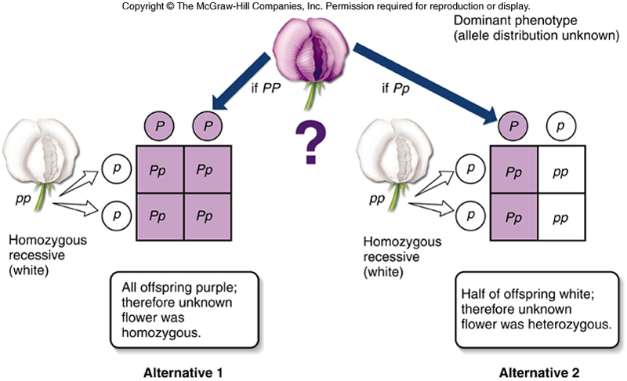
The test cross

Slide 18
Interpreting the test cross
If homozygous recessive (Pp):
The offspring comprise equal numbers of purple and white plants. If some of the plants are white (pp), then the unknown genotype must be Pp.
If all the offspring of the test cross were purple, then no definite conclusions could be drawn, since both parental genotypes, (PP and Pp) are capable of producing such offspring. However, provided a large number of offspring are produced, the absence of white flowers would strongly indicate that the unknown genotype was PP (homozygous dominant).

Slide 19
Dihybrid inheritance (law of independent assortment)
Dihybrid inheritance is the inheritance of two characteristics, each controlled by a different gene at a different locus.
In one experiment Mendel studied dihybrid inheritance by crossing plants from two pure-breeding strains: one tall with purple flowers, the other dwarf with white flowers.
All the offspring in the F₁ generation were tall with purple flowers, these being the dominant characteristics. The F₁ generation were self-crossed, producing the following phenotypes and ratios in the F₂ generation:
9 tall purple-flowered
3 tall white flowered
3 dwarf purple flowered
1 dwarf white flowered

Slide 20
F1 results

Slide 21
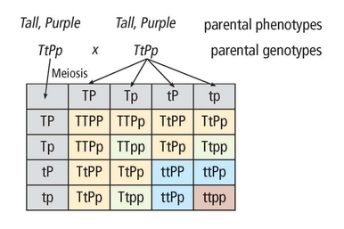
F2 results
Results:
9 tall purple-flowered
3 tall white flowered
3 dwarf purple flowered
1 dwarf white flowered

Slide 22
Mendel’s conclusions
He concluded from these results that the two pairs of characteristics behave quite independently of each other. This led him to formulate his second law of inheritance, the Law of Independent Assortment, which states that:
‘Either one of a pair of contrasted characters may combine with either of another pair’
With our current knowledge of genetics the law could now be rewritten as:
‘Either one of an allelic pair may combine randomly with either of another pair’

Slide 23
Chi-squared (Χ²) test
When performing the monohybrid cross Mendel’s actual results gave a ratio of 2.96:1, a very good approximation to the 3:1 ratio which the theory suggests should be achieved. Any discrepancy is due to statistical error.
Whether the variation from an expected ratio is the result of statistical chance or not can be tested for mathematically using the chi-squared test.

Slide 24
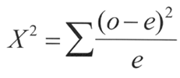
Chi-squared (Χ²) test
To calculate this value the following equation is used:
Where:
Σ = the sum of
(o – e) = difference between observed and expected results
x = the expected result

Slide 25
Chi-squared (Χ²) test
Using an example of the coin tossed 100 times, we can calculate the chi-squared value. We must first calculate the deviation from the expected number of times the coin should land heads:
Expected number of heads in 100 tosses of the coin (x) = 50
Actual number of heads in 100 tosses of the coin = 55
Deviation (o - e) = 5
Χ² = 5²/50 = 0.5

Slide 26
Chi-squared (Χ²) test
We can then make the same calculation for the coin landing tails:
Expected number of tails in 100 tosses of the coin (x) = 50
Actual number of tails in 100 tosses of the coin
= 55
Deviation (o - e) = 5
Χ² = 5²/50 = 0.5

Slide 27
Chi-squared (Χ²) test
Therefore:
The chi-squared value can now be calculated by adding these values:
Χ² = 0.5 + 0.5 = 1.0
To find out whether this value is significant or not we need to use a chi-squared table.

Slide 28
Chi-squared (Χ²) test
Degrees of freedom | Number of classes | Χ²
1 | 2 | 0.00 | 0.10 | 0.45 | 1.32 | 2.71 | 3.84 | 5.41 | 6.64
2 | 3 | 0.02 | 0.58 | 1.39 | 2.77 | 4.61 | 5.99 | 7.82 | 9.21
3 | 4 | 0.12 | 1.21 | 2.37 | 4.11 | 6.25 | 7.82 | 9.84 | 11.34
4 | 5 | 0.30 | 1.92 | 3.36 | 5.39 | 7.78 | 9.49 | 11.67 | 13.28
5 | 6 | 0.55 | 2.67 | 4.35 | 6.63 | 9.24 | 11.07 | 13.39 | 15.09
Probability that deviation is due to chance alone |  | 0.99 (99%) | 0.75 (75%) | 0.50 (50%) | 0.25 (25%) | 0.10 (1%) | 0.05 (5%) | 0.02 (2%) | 0.01 (1%)

Slide 29
Interpreting the (Χ²) test
To work out the number of degrees of freedom in our question it is the number of classes (or phenotypes) minus 1. Therefore in this example we have two possible classes (heads or tails) minus 1, giving 1 degree of freedom.
If the probability is greater than 0.05 (5%), the deviation is said to be not significant. If the deviation is less than 0.05 (5%), the deviation is said to be significant i.e. some factor other than chance is affecting the results.

Slide 30
Chi-squared (Χ²) test
Degrees of freedom | Number of classes | Χ²
1 | 2 | 0.00 | 0.10 | 0.45 | 1.32 | 2.71 | 3.84 | 5.41 | 6.64
2 | 3 | 0.02 | 0.58 | 1.39 | 2.77 | 4.61 | 5.99 | 7.82 | 9.21
3 | 4 | 0.12 | 1.21 | 2.37 | 4.11 | 6.25 | 7.82 | 9.84 | 11.34
4 | 5 | 0.30 | 1.92 | 3.36 | 5.39 | 7.78 | 9.49 | 11.67 | 13.28
5 | 6 | 0.55 | 2.67 | 4.35 | 6.63 | 9.24 | 11.07 | 13.39 | 15.09
Probability that deviation is due to chance alone |  | 0.99 (99%) | 0.75 (75%) | 0.50 (50%) | 0.25 (25%) | 0.10 (1%) | 0.05 (5%) | 0.02 (2%) | 0.01 (1%)

Slide 31
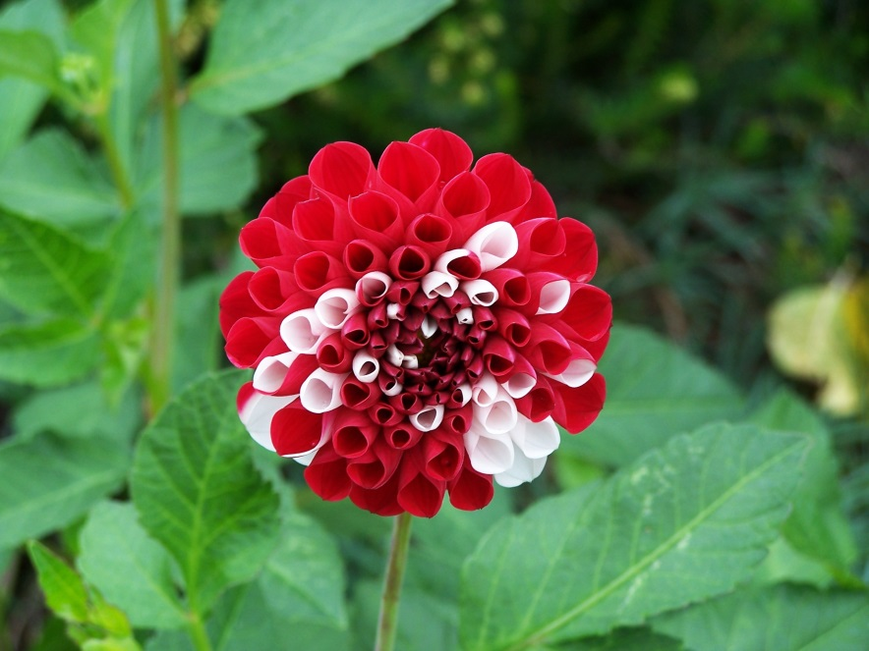
Codominance
Not all characteristics are determined by single genes which behave independently, as was the case in Mendel’s experiments.
Sometimes, alleles express themselves equally in the phenotype, therefore neither is dominant. This is called codominance.

Slide 32
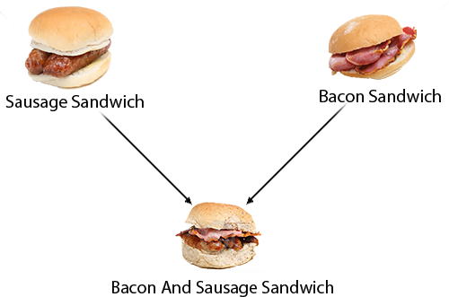
Codominance
Codominance means that the heterozygous condition produces a different phenotype from the homozygous dominant or homozygous recessive conditions.

Slide 33
Codominance
As neither allele is dominant, the different alleles are not represented by upper case and lower case letters. Instead the gene is given an upper case letter and each allele is represented by a superscript upper case letter e.g.
C^{R} C^{R} – red flower
C^{R} C^{W} – pink flower
C^{W} C^{W} – white flower

Slide 34
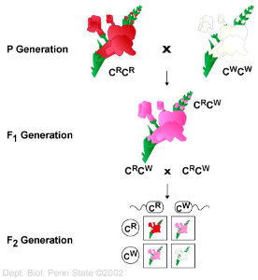
Codominance
For example, in Antirrhinum (snapdragon), two alleles for colour are codominant.
Homozygous individuals may be either red or white, whereas heterozygous individuals are pink.
The ratio, therefore, is as follows:
1 : 2 : 1
red pink white

Slide 35
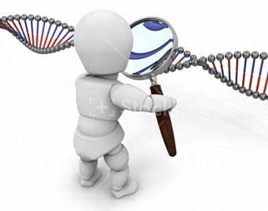
Linkage

Slide 36
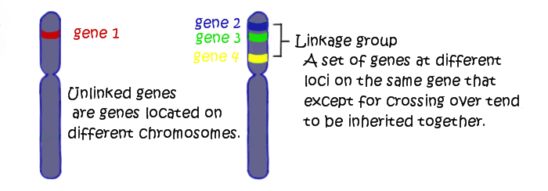
Linkage
The alleles of different genes cannot assort independently if the genes are on the same chromosome.
Such genes are said to be linked because they tend to be inherited together i.e. they do not segregate in accordance with Mendel’s Law of Independent Assortment.

Slide 37
Meiosis and linkage
During meiosis linked genes are inherited together because they pass into the gamete, and hence the offspring, together.
During meiosis, at least one chiasma forms between two homologous chromosomes. However, it may not form between a particular pair of genes. The further apart the genes are, the more likely it is that crossing over will result in the formation of recombinants.

Slide 38
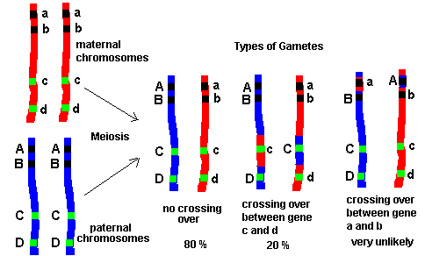
Meiosis and linkage

Slide 39
Sex Determination

Slide 40
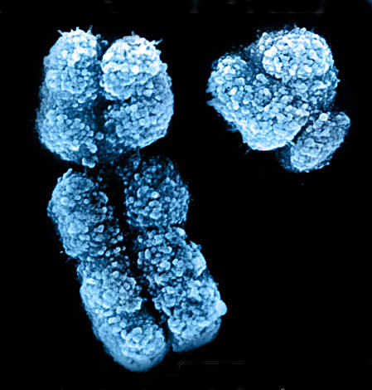
Sex chromosomes
In humans, there are 23 pairs of chromosomes. Of these, 22 pairs are identical in both sexes. The 23rd pair, however, is different in the male from the female.
The 22 identical pairs are called autosomes, whereas the 23rd pair are referred to as sex chromosomes or heterosomes.

Slide 41
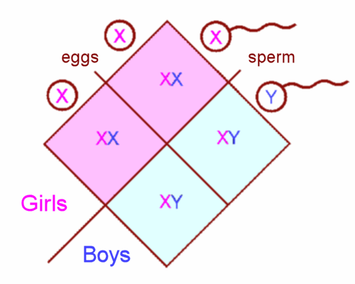
Gametes
It can be seen that in humans the female produces gametes which all contain an X chromosome and are therefore the same.
The male, however, produces gametes of two genetic types: 50% of the sperm contain an X chromosome and 50% contain a Y chromosome.

Slide 42
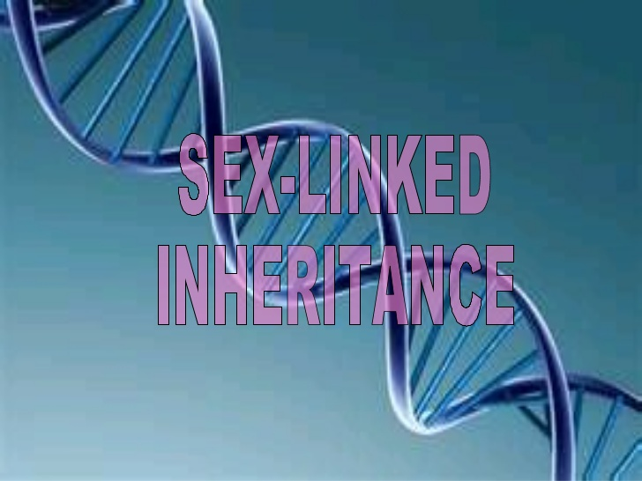

Slide 43
Sex-linkage
Genes that are located on one or the other of the sex chromosomes are said to be sex-linked. These genes determine body characters and have nothing to do with sex.
Sex-linked genes may be on the X chromosome (X-linkage) or the Y chromosome (Y- linkage). The X chromosome carries many such genes, the Y chromosome has very few.
In humans, features linked on the Y chromosome will only arise in males, whereas features linked on the X chromosome may arise in either sex.

Slide 44
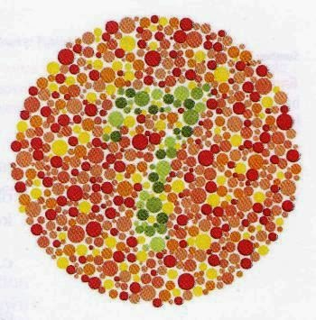
X-linkage
Because the X chromosome is much larger than the Y chromosome, most sex-linked genes are located on the X chromosome.
The X chromosome carries genes for characteristics such as the ability to see particular colours and the ability to clot blood efficiently.

Slide 45
X-linkage
In X-linkage, recessive alleles will express themselves more often in the phenotype of the male. This is because they are unpaired and so there is no dominant allele present.
Females with a recessive allele on only one of their X chromosomes will not be affected by it as the dominant allele on the other X chromosome will mask the effect of the recessive allele.
These females are heterozygous for a sex-linked recessive trait and are known as carriers. They have a 50% chance of passing on the recessive allele to their sons.

Slide 46
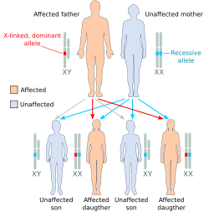
X-linkage
An important feature of X-linkage is that a male cannot pass on an X-linked characteristic to his sons as they must receive the Y chromosome to become male.
On the other hand, all his daughters must receive the recessive allele from him.

Slide 47
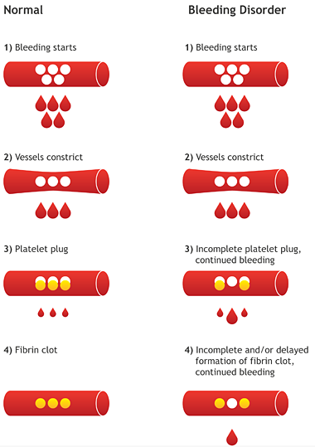
Haemophilia
Haemophilia is a condition in which the blood does not clot normally. Haemophilia often results in excessive bleeding, both internally and externally.
The condition is due to the lack of one or more clotting factors, which play an important role in the complex chain reaction of blood clotting.

Slide 48
Haemophilia A in males
Haemophilia A is a sex-linked characteristic caused by a recessive allele carried on the X chromosome.
Females have a pair of alleles for the gene that controls the production of Factor VIII, but males have only one. Therefore, if a male inherits one allele for haemophilia A, he has the disease because he cannot possess another allele which might mask its effects.

Slide 49
Haemophilia A in females
A female only has the disease if she has inherited two recessive alleles, one from each parent.
Heterozygous females are carriers of the disease, therefore there is a 50% chance of a carrier mother transmitting the recessive allele to any one of her sons.

Slide 50
Haemophilia genetics

Slide 51
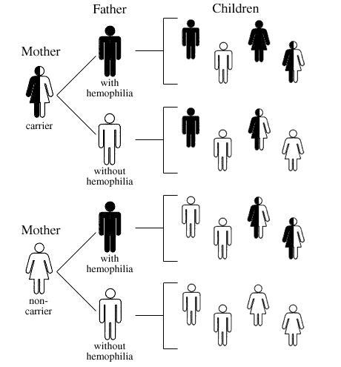

Slide 52
Haemophilia in the Royal family
The inheritance of haemophilia within a family can be shown in a pedigree (a chart of the ancestral history of a group of related individuals). One of the best established pedigrees for haemophilia is that of Queen Victoria’s family.

Slide 53
