Slide 1
Specification outcomes You should be able to discuss...
Formation of recombinant DNA by insertion of foreign DNA into bacterial plasmids and cloning of the bacteria to produce useful molecules as illustrated by insulin.
The use of restriction endonuclease, DNA ligase, reverse transcriptase, marker gene. Advantages and disadvantages of genetic engineering.

Slide 2
Learning objectives You should be able to...
Grade B
Describe the process involved in the genetic engineering of bacteria to produce human insulin
Grade A
Evaluate other potential applications of genetic engineering
Grade A*
Compare the standard method of genetic engineering with the new CRISPR and CAS9 method

Slide 3
Restriction enzymes
http://www.nobelprize.org/nobel_prizes/medicine/laureates/1978/

Slide 4
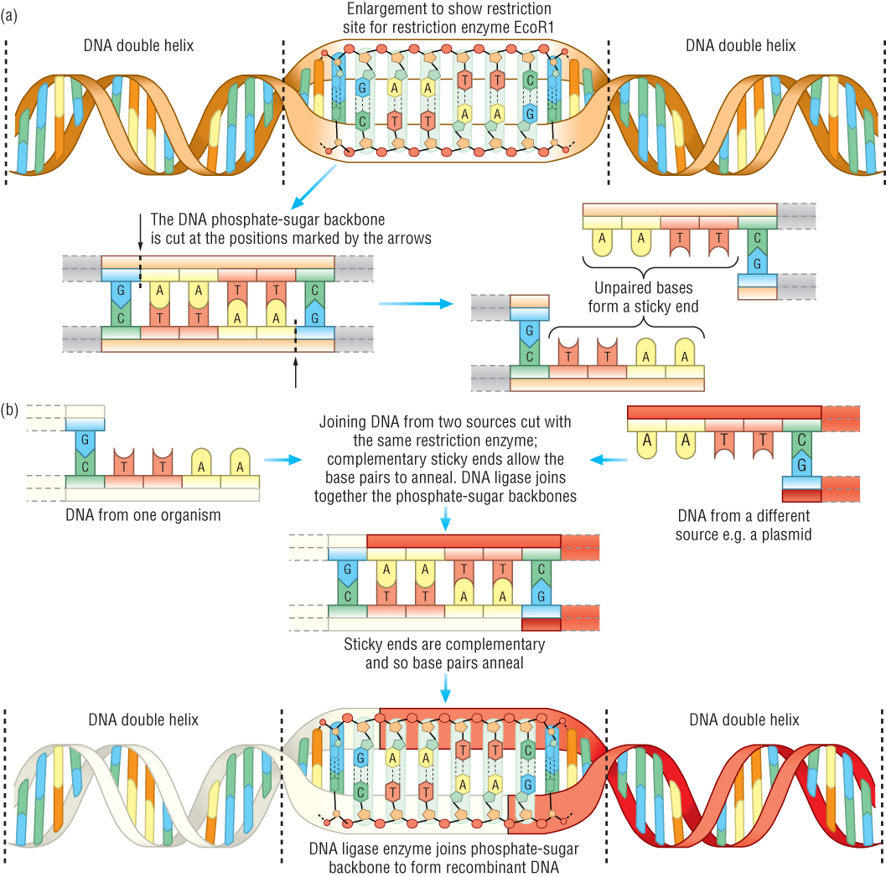
(a) Cutting DNA using a restriction enzyme produces a staggered cut and leaves sticky ends.
(b) Joining DNA from two sources cut with the same restriction enzyme; complementary sticky ends allow the base pairs to anneal.

Slide 5
Get these 5 processes in the correct order
Extension – explain how sticky ends are formed and how they are useful in genetic manipulation

Slide 6
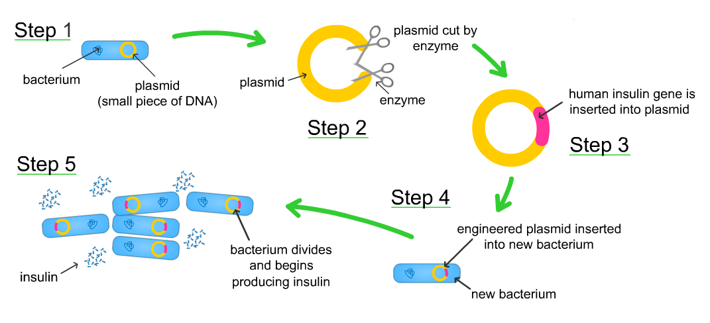
Answer

Slide 7
GM explained
http://www.youtube.com/watch?v=BSsnul-xN7Q

Slide 8
GM notes
http://www.s-cool.co.uk/a-level/biology/genetic-engineering

Slide 9
Match them up!!
cDNA
To join DNA fragments together
Restriction Enzymes
To deliver a gene to a living cells
DNA Ligase
To carry DNA into cells and ensure replication
Vectors
A DNA copy of mRNA
Plasmids
To cut DNA at specific points, making small fragments
Gene Transfer
Common kind of vector

Slide 10
cDNA
A DNA copy of mRNA
Restriction Enzymes
To cut DNA at specific points, making small fragments
DNA Ligase
To join DNA fragments together
Vectors
To carry DNA into cells and ensure replication
Plasmids
Common kind of vector
Gene Transfer
To deliver a gene to a living cells

Slide 11
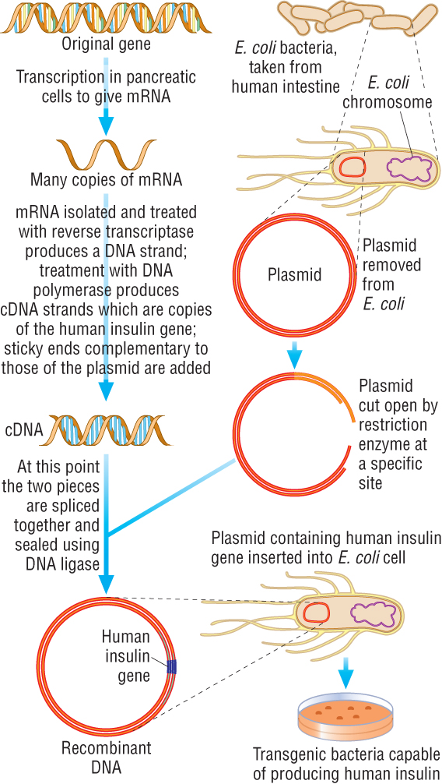
Week 22
Production of bacteria containing the human insulin gene
© Pearson Education Ltd 2009
This document may have been altered from the original

Slide 12
Outline how animals can be genetically engineered for xenotransplantation

Slide 13
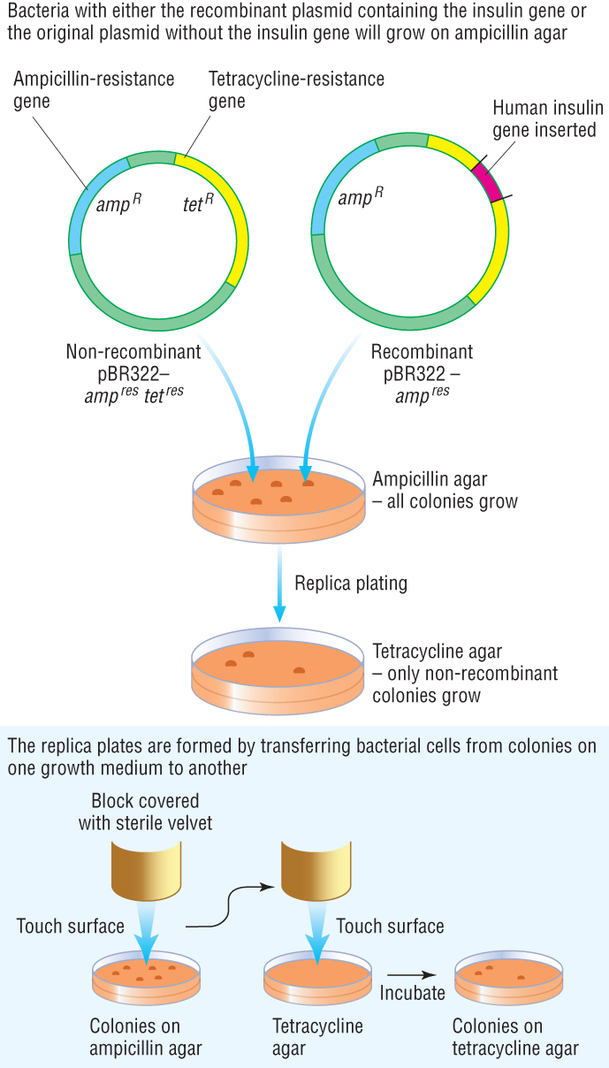
Identification of transformed bacteria by replica plating
© Pearson Education Ltd 2009
This document may have been altered from the original
Notes:
13

Slide 14
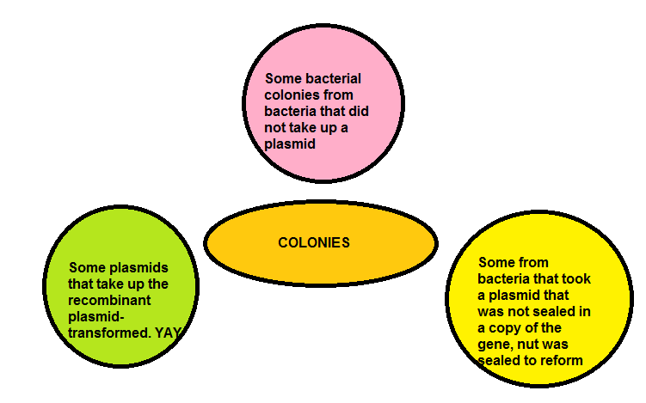
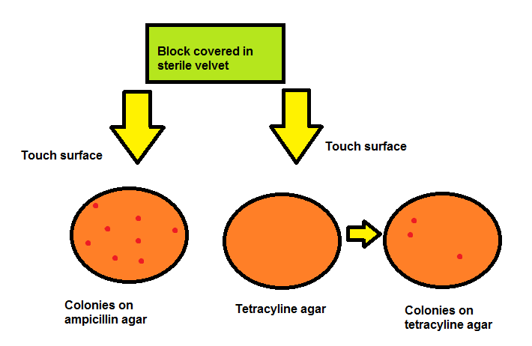

Slide 15
Applications – the future?
http://www.youtube.com/watch?v=rD5uNAMbDaQ&feature=relmfu
Synthetic Biology Explained

Slide 16
Applications of GM
Dragon’s den.
Imagine you have £1m to invest in GM research. Where would you invest your money and why?
Arrange your answers in a pyramidesque shape:
5.2.3 (s): discuss the ethical concerns raised by the genetic manipulation of animals (including humans), plants and microorganisms
Rate each application on a scale of 1-5.
1 = no ethical concern, 5 = severe ethical concerns

Slide 17
Learning objectives You should be able to...
Grade B
Describe the process involved in the genetic engineering of bacteria to produce human insulin
Grade A
Evaluate other potential applications of genetic engineering
Grade A*
Compare the standard method of genetic engineering with the new CRISPR and CAS9 method

Slide 18
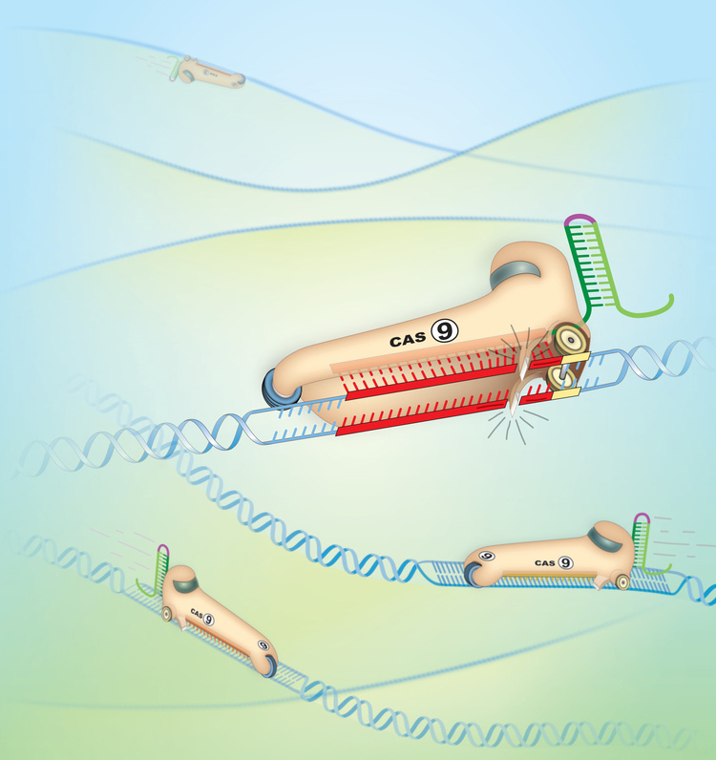
CAS9 The best thing to happen in GM since 1978!

Slide 19
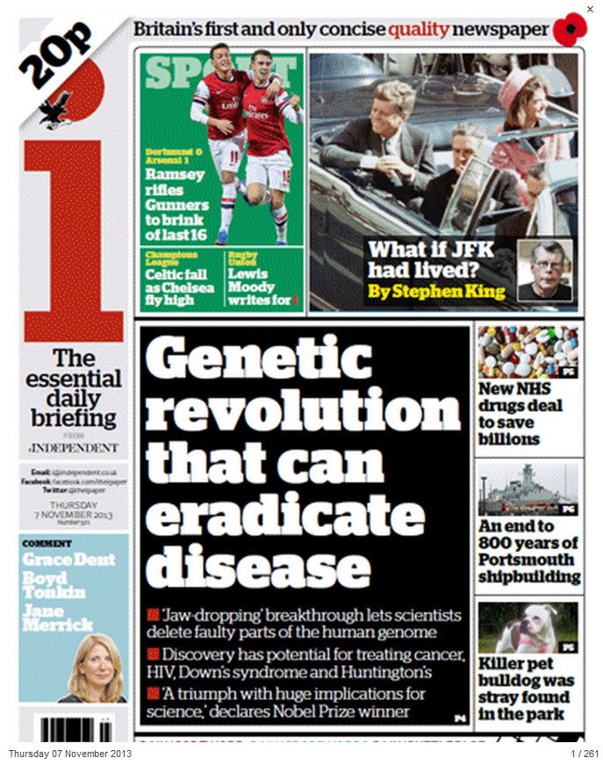
November 2013
http://www.independent.co.uk/news/science/exclusive-jawdropping-breakthrough-hailed-as-landmark-in-fight-against-hereditary-diseases-as-crispr-technique-heralds-genetic-revolution-8925295.html

Slide 20
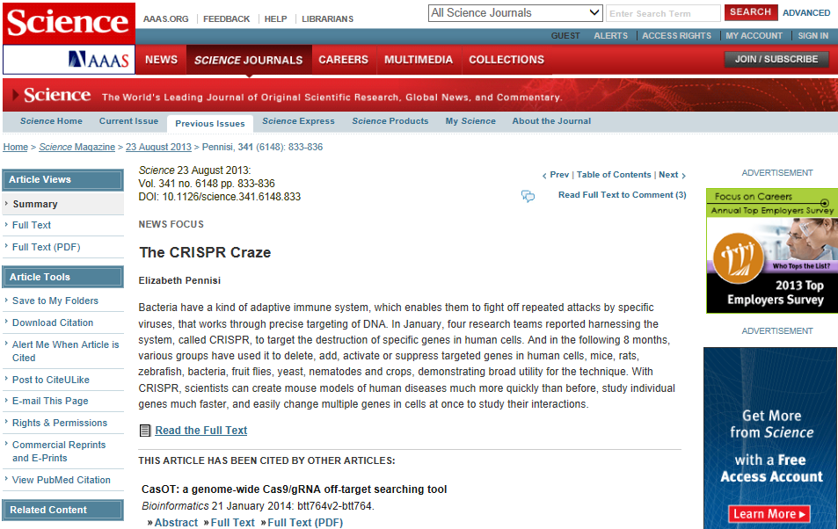
http://www.sciencemag.org/content/341/6148/833.summary

Slide 21
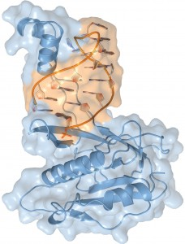
The crystal structure of the Csy4 enzyme (blue) bound to a crRNA molecule (orange).

Slide 22
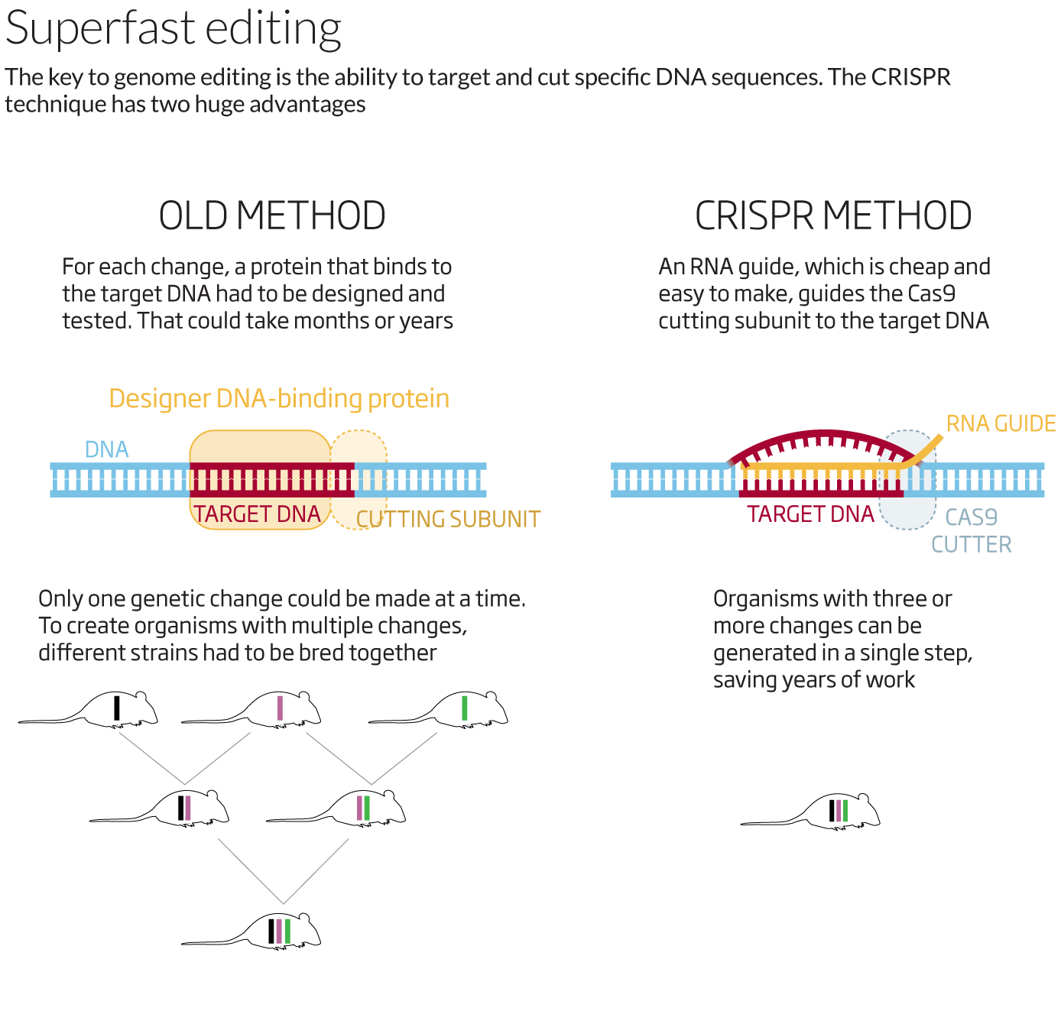
http://www.newscientist.com/article/mg22129530.900-right-on-target-new-era-of-fast-genetic-engineering.html?page=3#.Uu2BjrmYZtQ

Slide 23
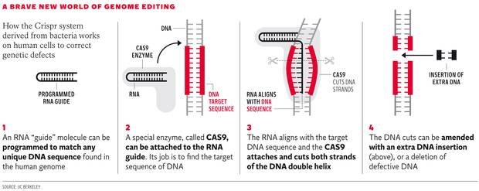
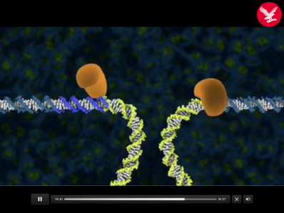
http://www.independent.co.uk/news/science/indyplus-video-crispr-technique-8925604.html

Slide 24
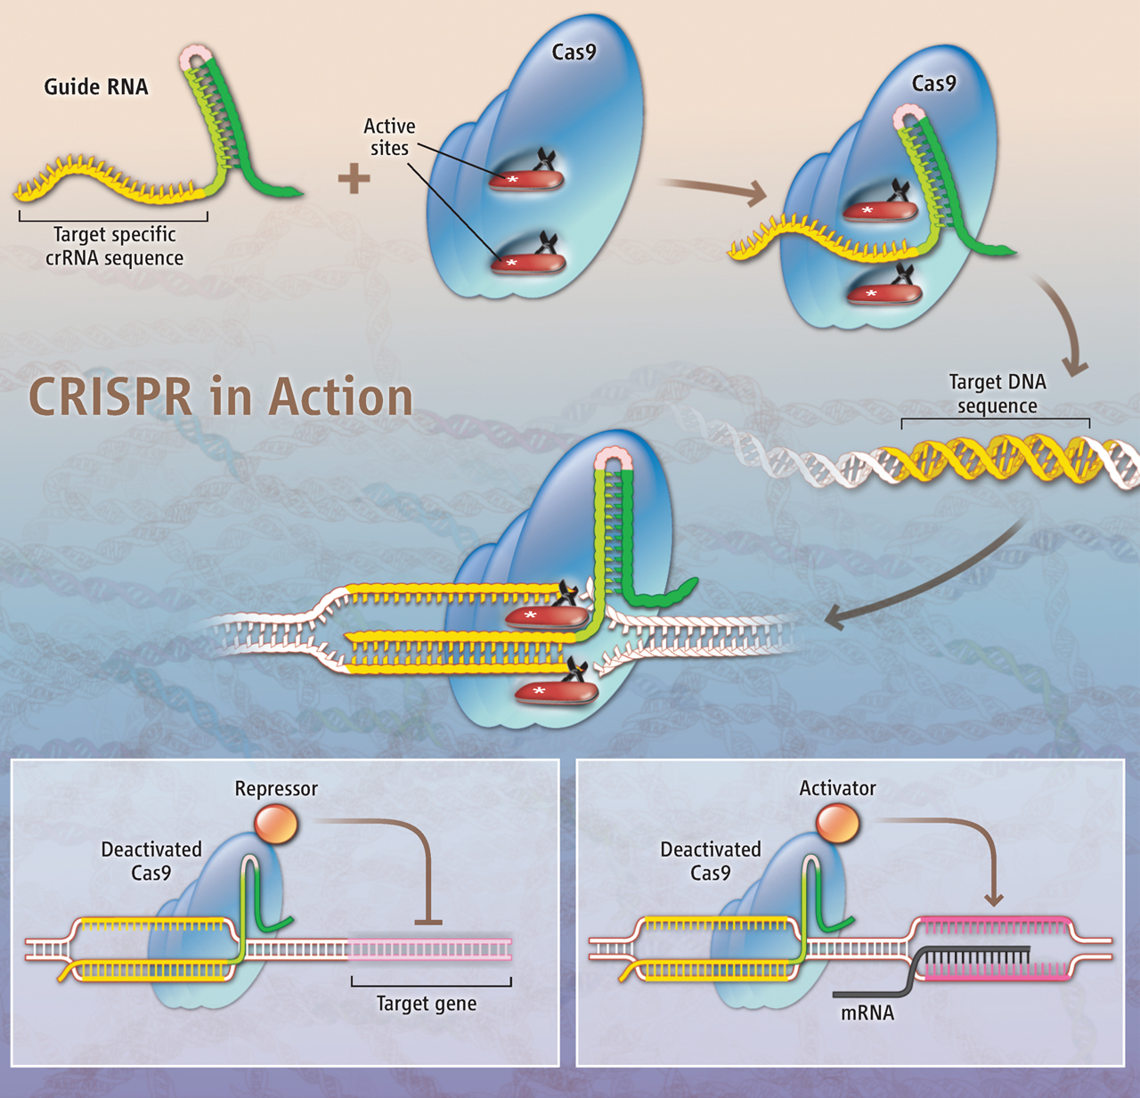
The CRISPR/Cas system. (From E. Pennisi, Science, 341:833-6, 2013.

Slide 25
Advances are being made every day! This is from last Thursday...
http://www.theguardian.com/science/2014/jan/30/genetically-modified-monkeys-cut-and-paste-dna-alzheimers-parkinsons

Slide 26
Prof. Malcolm White (St Andrews Uni) talks about his work on the CRISPR system
http://www.youtube.com/watch?v=Sj953m9iFsA

Slide 27
Pick your target grade
Grade B
Describe the process involved in the genetic engineering of bacteria to produce human insulin
Grade A
Evaluate other potential applications of genetic engineering
Grade A*
Compare the standard method of genetic engineering with the new CRISPR and CAS9 method
Describe how human insulin is produced using the following key terms:
ligase, enzyme, restriction, recombinant, plasmid, vector
Outline the main advantages of using recombinant E. coli for insulin production and some limitations of this 1980s technology
Draw up a table that compares the similarities and differences between the 1980s method of genetically engineering and the 2013/14 method

