Slide 1
http://www.youtube.com/watch?v=XTUm-75-PL4

Slide 2
Enzymes
(a) You should be able to discuss…
Metabolism as a series of enzyme controlled reactions.
The protein nature of enzymes. Enzymes may act intracellularly or extracellularly.
Active sites interpreted in terms of three dimensional structure, theory of induced fit as illustrated by lysozyme.

Slide 3
What is an Enzyme?
Organic (biological) catalyst
Speeds up chemical reactions that would otherwise occur very slowly
Catalyst: is left unchanged at end of reaction
does not change the end product
REVISION: anabolic and catabolic reactions
http://www.northland.cc.mn.us/biology/biology1111/animations/enzyme.swf

Slide 4
Fun fact game
1. Enzymes are globular proteins.
2. They reduce the activation energy needed for a reaction to proceed and produce products.
3. Enzymes have a region called an active site. The site is the "lock" into which a substrate "key" fits.
4. The enzyme then fits closely around the substrates. This is called induced fit.
5. Enzyme activity is affected by substrate type, temperature, pH and substrate concentration.
6. Enzyme activity can be inhibited or promoted by other substances.

Slide 5
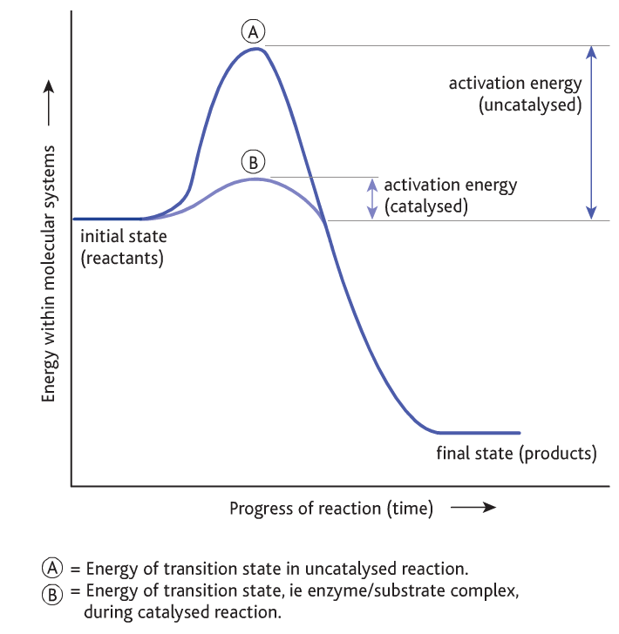
What do enzymes do??
Reactions require ENERGY
ACTIVATION ENERGY
Enzymes lower the activation energy of a reaction
Substrate + enzyme
Substrate/enzyme complex
Enzyme + product

Slide 6
Enzymes – key facts
An enzyme is a biological catalyst
The pockets formed by tertiary and quaternary structure can hold specific substances (SUBSTRATES)
These pockets are called ACTIVE SITES
When all the proper substrates are nestled in a particular enzyme's active sites, the enzyme can cause them to react quickly
Once the reaction is complete, the enzyme releases the finished products and goes back to work on more substrate

Slide 7
Enzyme structure and function
Globular proteins: active site (often depression or cleft on the enzyme surface)
Relies on 3D structure – if changed enzyme it won’t function
Enzymes only change the RATE OF REACTION
Enzymes are present in low/small concentrations – you don’t need a lot to catalyse a reaction because they are so good!!
Molecular activity/turnover – concentration of substrate utilised per min (e.g. catalase has a turnover of 6x10⁶ min⁻¹)

Slide 8
Lock and Key hypothesis vs. Induced Fit (See website)

Slide 9
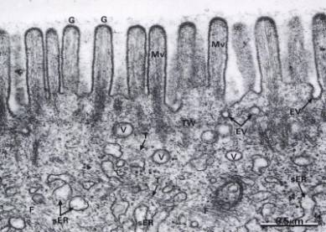
Where do enzymes act?
Enzymes are made in living cells
May be used inside that cell (intracellular)
Or on the outside (extracellular)
How do they get out??

Slide 10
Enzymes
(a) You should be able to discuss…
Metabolism as a series of enzyme controlled reactions.
The protein nature of enzymes. Enzymes may act intracellularly or extracellularly.
Active sites interpreted in terms of three dimensional structure, theory of induced fit as illustrated by lysozyme.
Page in book???

Slide 11
Blood cocktail
http://www.youtube.com/watch?v=LlxKfSbpoX0

Slide 12
Timeline of enzyme discovery
1835:
Breakdown of starch to sugar by malt
1877:
Name enzyme coined to describe chemicals in yeast that ferment sugars
1897:
Eduard Buchner extracted enzyme from yeast and showed it could work outside cells
1905:
Otto Rohm exyracted pancreatic proteases to supply enzymes for tanning
1926:
James B Sumner produced first pure crystalline enzyme (urease) and
showed enzymes were proteins
1930-1936:
Protein nature of enzymes finally established when digestive enzymes
crystallised by John H Northrop
1946: Sumner finally awarded Nobel prize

Slide 13
Enzymes
(b) You should be able to describe…
The meaning of catalysis; the lowering of the activation energy.
The principles of competitive and non competitive inhibition (references to reversible and irreversible action not required).
Maybe biosensors?

Slide 14
Inhibition of enzymes
Inhibitors slow down the rate of a reaction
Competitive inhibitors: these molecules have a similar structure to the actual substrate and so will bind temporarily with the active site.
Non-competitive inhibitors: these molecules are not necessarily anything like the substrate in shape. They bind with the enzyme, but not at the active site.

Slide 15
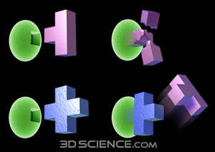
Enzyme Inhibitors:
Inhibition occurs when enzyme action is slowed down or stopped by another substance. The inhibitor combines with the enzyme and stops it forming an enzyme-substrate complex.
There are two types of inhibitor:
COMPETITIVE INHIBITOR
NON-COMPETITIVE INHIBITOR

Slide 16
Competitive Inhibitors:
The inhibitor is structurally similar to the substrate and competes with the active site for the enzyme.
I.e. the inhibitor has a shape that lets it fit into the active site of the enzyme in place of the substrate.
For example, malonic acid competes with succinate for the active sites of succinic dehydrogenase, an important enzyme in the Krebs cycle in respiration.
If the substrate concentration is increased it will reduce the effect of the inhibitor.
This is because the more substrate molecules present the greater the chance of finding active sites, leaving fewer to be occupied by the inhibitor.

Slide 17
Non-Competitive Inhibitors:
These inhibitors bind to the enzyme at a site away from the active site.
This alters the overall shape of the enzyme molecule, including the active site, in such a way that the active site can no longer accommodate the substrate.
As the substrate and inhibitor molecules attach to different parts of the enzyme they are not competing for the same sites.
The rate of reaction is therefore unaffected by substrate concentration.
For example, cyanide (a respiratory poison) attached itself to part of the enzyme, cytochrome oxidase, and inhibits respiration.

Slide 18
http://www.stolaf.edu/people/giannini/flashanimat/enzymes/allosteric.swf
http://www.heartfailurematters.org/EN/Animation/Pages/animation_7.aspx
http://www.wiley.com/college/pratt/0471393878/student/animations/enzyme_inhibition/index.html

Slide 19
http://www.kscience.co.uk/animations/model.swf

Slide 20
Plenary
Inhibition q

Slide 21
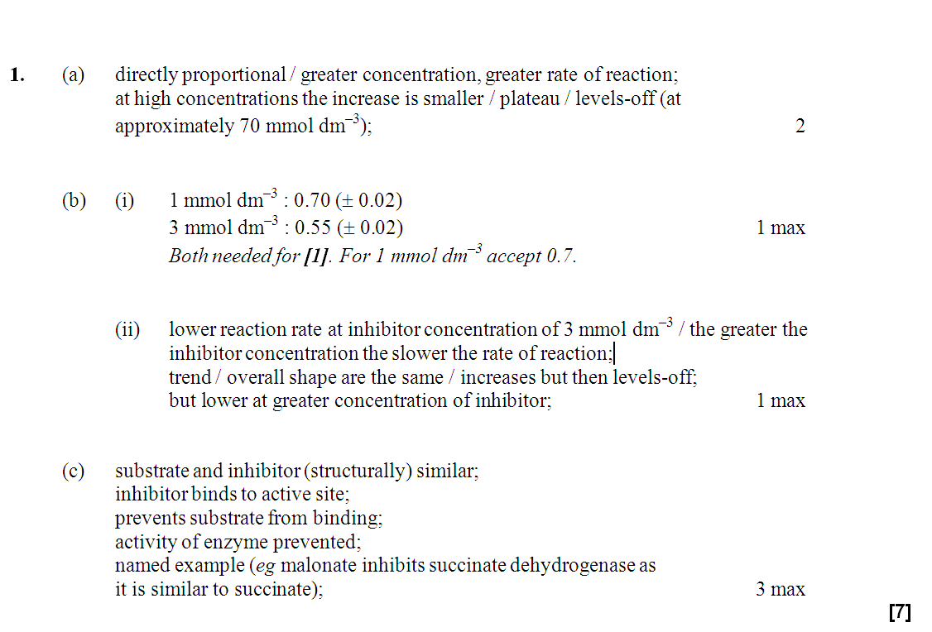

Slide 22
Objectives I should be able to…
3.6.5 Explain the use of lactase in the production of lactose-free milk using immobilised enzymes.

Slide 23
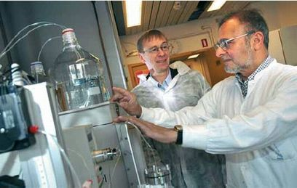
Enzymes in Industry
describe how enzymes can be immobilised;
explain why immobilised enzymes are used in large-scale production;

Slide 24
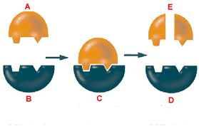
Enzymes as Catalysts
Enzymes are used to speed up chemical (metabolic) reactions e.g. respiration or photosynthesis- so why use enzymes in industry?
They are specific
can catalyse reactions between specific chemicals, even in a large mixture
form fewer bi-products
less purification needed
Function well at relatively low temperatures saving money on fuel costs
Enzymes from thermophilic bacteria can be extracted and used at high temperatures

Slide 25
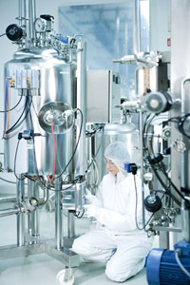
Isolating Enzymes
In some biotechnological processes, whole organisms are cultured to generate products, however when you need a single product, it is more efficient to isolate the enzyme
They can be isolated in large quantities
The extraction of enzymes from a fermentation mixture is known as downstream processing which is the separation and purification of any product of large scale fermentations

Slide 26
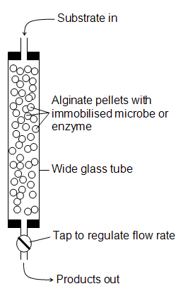
Immobilising Enzymes
Enzyme-substrate complexes must be formed in order to gain the products
The easiest way is to mix the isolated enzyme with the substrate, however the product must then be separated which can be a costly process
It is therefore possible to immobilise enzymes so they can catalyse the reaction without mixing freely

Slide 27
Advantages of Immobilised Enzymes
Enzyme not mixed with products so purification/ downstream processing costs are low
Enzymes available immediately for re-use which is good for continuous processes
The enzymes are more stable as the immobilising matrix protects the enzyme molecules

Slide 28
Disadvantages of Immobilised Enzymes
Additional time, equipment and materials needed, so expensive to set up
Can be less active as they do not mix freely with the substrate
Contamination can be costly if it occurs as the whole system needs to be stopped

Slide 29
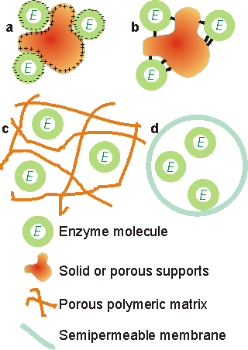
There are four principal methods available for immobilising enzymes
adsorption
covalent binding
entrapment
membrane confinement
Figure 3.1. Immobilised enzyme systems. (a) enzyme non-covalently adsorbed to an insoluble particle; (b) enzyme covalently attached to an insoluble particle; (c) enzyme entrapped within an insoluble particle by a cross-linked polymer; (d) enzyme confined within a semipermeable membrane.

Slide 30
Immobilisation in a Nutshell
Method | Description
Adsorption | Enzyme mixed with immobilising supports e.g. porous carbon, glass beads, clay & resins with hydrophobic interactions and ionic links*. Detachment is possible due to weak bonds but reaction rates are high if active site is displayed.
Covalent Bonding | Enzymes covalently linked to insoluble material e.g. clay using cross linking agent (gluteraldehyde/sepharose) Binding is strong, so very little enzyme leakage, but small quantities only
Entrapment | Enzymes trapped in a gel bead or cellulose fibre network. Active sites are not affected, but reaction rates reduced if substrate can’t get through trapping barrier
Membrane Separation | Enzymes separated by a partially permeable membrane. Enzyme on one side, substrate on another. Substrate molecules and products can pass across the membrane.
*An ionic bond is a type of chemical bond formed through electrostatic attraction between two oppositely charged ions.

Slide 31
PPT
Weird cat

Slide 32
advantages | disadvantages
cost of development is very high | products need less purification as they don't contain the used enzyme
easier to separate the enzyme from the product | reaction can be continuous and so cheaper
enzyme can become detached from its solid support | shape of the active site might be changed when immobilised
enzymes can be reused | shape of the enzyme might be changed when immobilised

Slide 33
Cut and stick the advantages and disadvantages of immobilised enzymes
advantages | disadvantages
cost of development is very high | products need less purification as they don't contain the used enzyme
easier to separate the enzyme from the product | reaction can be continuous and so cheaper
enzyme can become detached from its solid support | shape of the active site might be changed when immobilised
enzymes can be reused | shape of the enzyme might be changed when immobilised

Slide 34
advantages | disadvantages
products need less purification as they don't contain the used enzyme | shape of the enzyme might be changed when immobilised
enzymes can be reused | shape of the active site might be changed when immobilised
easier to separate the enzyme from the product | cost of development is very high
reaction can be continuous and so cheaper | enzyme can become detached from its solid support

Slide 35
Enzymes
(b) You should be able to describe…
pH, substrate and enzyme concentration on rate of activity.
Inactivation and denaturation.
The need for scientific method in carrying out experiments and investigations.

Slide 36
Factors Affecting the Rate of Enzyme Action:
Enzymes are made inside living cells but may act inside the cell (INTRAcellular) or outside (INTERcellular, EXTRAcellular) such as the digestive enzymes of the alimentary canal.
Environmental conditions can change the 3D structure of enzyme molecules.
Bonds are broken and hence the configuration of the active site is altered.
TEMPERATURE
SUBSTRATE CONCENTRATION
pH
ENZYME CONCENTRATION

Slide 37
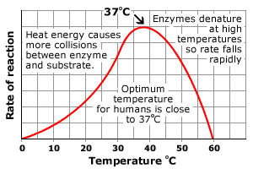
Effect of Temperature:
Increase in temperature gives molecules greater kinetic energy and they move around more quickly increasing the chance of molecules colliding. This causes an enzyme controlled reaction to increase its rate of reaction.
As a general rule, the rate of reaction doubles for each 10⁰C rise in temperature until an OPTIMUM temperature is reached. For most enzymes this is 40⁰C.
Above this temperature the increasing vibration of the molecules cause the hydrogen bonds to break and cause a change in the tertiary structure of the enzyme. This alters the active site of the enzyme.
The enzyme is then said to be DENATURED. This is a permanent change in the structure . At low temperatures, the enzyme in inactivated as the molecules have no kinetic energy. However, the enzyme can work again if the temperature is raised!

Slide 38
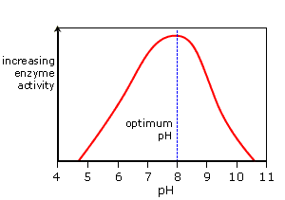
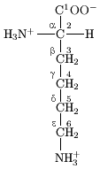
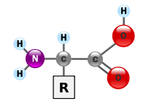
Effect of pH:
The rate of an enzyme catalysed reaction will vary with changes in pH. Enzymes have a narrow optimum range and small changes in pH can affect the rate of reaction without affecting the structure of the enzyme.
Small changes in pH outside the optimum can cause small reversible changes in enzyme structure and results in inactivation. Extremes of pH can denature the enzyme.
The charges on the amino acid side-chains of the enzyme’s active site are affected by free hydrogen ions or hydroxyl ions.
In the formation of an enzyme substrate complex the charge on the active site must match those of the substrate. E.g. if the active site has too many H⁺ ions, the active site and the substrate may both have the same charge and the enzyme will repel the substrate.
At extremes of pH, the hydrogen bonding is affected and the 3D shape of the enzyme is altered and so is the shape of the active site.

Slide 39
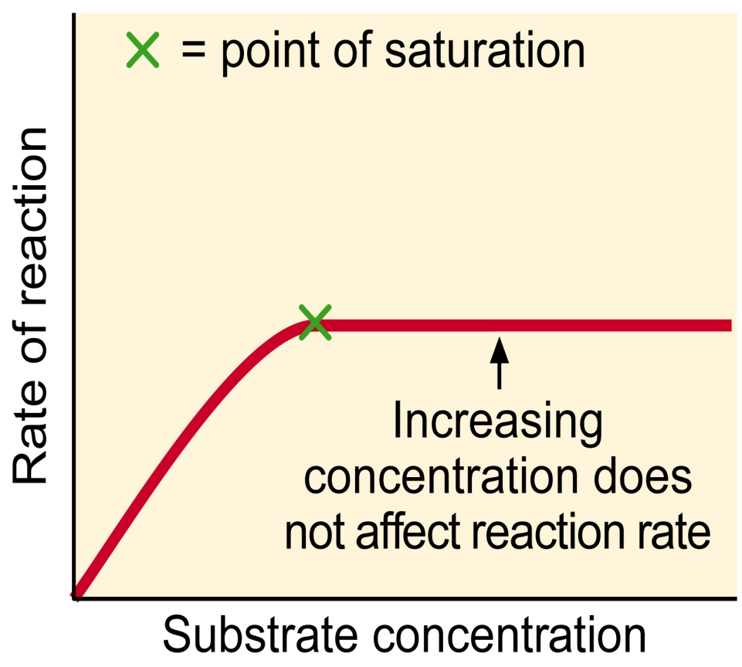
Concentration:
SUBSTRATE CONCENTRATION – the rate of an enzyme catalysed reaction will vary with changes in substrate concentrations.
If the amount of enzyme is constant the rate of reaction will increase as the substrate increases.
But there must come a point when all the enzyme’s active sites are working to full capacity i.e. all the active sites are filled.
ENZYME CONCENTRATION – the rate of an enzyme catalysed reaction will vary the changes in enzyme concentration.
Increasing the enzyme concentration will increase the rate of reaction.

Slide 40
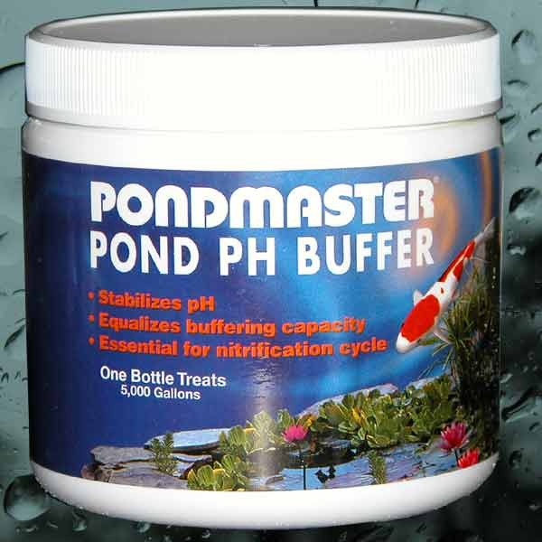
Enzyme Experiments:
In enzyme experiments it is essential that buffers and controls are used.
BUFFERS – maintain a constant pH. When a buffer is used in an experiment the pH changes little when a small quantity of acid or alkali is added.
It can be said that a buffer ‘soaks up hydrogen ions (H⁺)’.
CONTROL – controls are duplicate experiments, identical in every respect to the actual experiment, except for the variable being investigated, which is kept constant.
For example, boiled enzyme may be used in a control experiment instead of the enzyme.

Slide 41
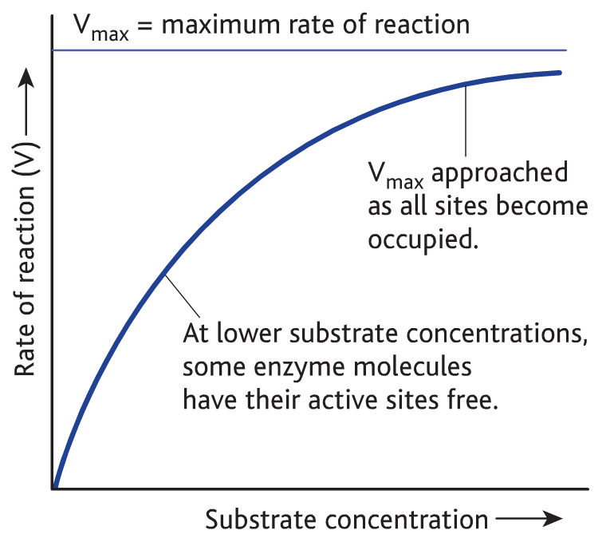
Enzyme activity: the effect of change in concentration
substrate + enzyme → product
Increasing [substrate/enzyme] means more substrate/enzyme is available for the enzyme so there is more product made

Slide 42
Enzyme activity: the effect of change in concentration
Enzyme concentration:
at low enzyme concentration there is great competition for the active sites and the rate of reaction is low
As the enzyme concentration increases, there are more active sites and the reaction can proceed at a faster rate
Eventually, increasing the enzyme concentration beyond a certain point has no effect because the substrate concentration becomes the limiting factor.

Slide 43
Enzyme activity: the effect of change in concentration
Substrate concentration:
at a low substrate concentration there are many active sites that are not occupied. This means that the reaction rate is low
When more substrate molecules are added, more enzyme-substrate complexes can be formed
Eventually, increasing the substrate concentration yet further will have no effect. The active sites will be saturated so no more enzyme-substrate complexes can be formed.

Slide 44
Enzyme activity: the effects of change in temperature
Temperature: enzymes work best at an optimum temperature.
Q₁₀ = rate reaction at (x + 10)ºC
rate reaction at x ºC
Between 0-40ºC this works out as 2
So…an increase in temp. of 10ºC causes the rate of reaction to double
Enzymes start to denature over 40ºC and most are completely denatured at 60ºC

Slide 45
Enzyme activity: the effect of change in pH.
pH: enzymes have an optimum pH.
If the pH changes much the chemical nature of the amino acids can change. The active site will be disrupted and the enzyme will be denatured

