Slide 1
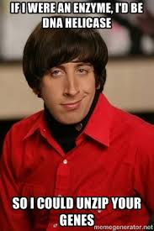
The genetic code and cell function

Slide 2
http://genome.pfizer.com/zipunzip.cfm

Slide 3
You should be able to…
● Know the structure of DNA, including the structure of the nucleotides (purines and pyrimidines), base pairing, the two sugar-phosphate backbones, phosphodiester bonds and hydrogen bonds.
● Understand how DNA is replicated semi-conservatively, including the role of DNA helicase, polymerase and ligase.
● Know that a gene is a sequence of bases on a DNA molecule coding for a sequence of amino acids in a polypeptide chain.
● Know the structure of mRNA including nucleotides, the sugar phosphate backbone and the role of hydrogen bonds.
● Know the structure of tRNA, including nucleotides, the role of hydrogen bonds and the anticodon.
● Understand the processes of transcription in the nucleus and translation at the ribosome, including the role of sense and anti-sense DNA, mRNA, tRNA and the ribosomes.
● Understand the nature of the genetic code, including triplets coding for amino acids, start and stop codons, degenerate and non-overlapping nature, and that not all the genome codes for proteins.
● Understand the term gene mutation as illustrated by base deletions, insertions and substitutions.
Understand the effect of point mutations on amino acid sequences, as illustrated by sickle cell anaemia in humans.

Slide 4
Semi-Conservative Model

Slide 5
Two theories existed...
Conservative Hypothesis
The complete parent DNA molecule acts as a template for the new daughter molecule, which is assembled from new nucleotides. The parent molecule is unchanged.
Semi-conservative Hypothesis
The parent DNA molecule separates into its two component strands, each of which acts as a template for the formation of a new complementary strand. The two daughter molecules therefore contain half the parent DNA and half new DNA (semi-conservative hypothesis).

Slide 6
2 models

Slide 7
http://www.learnerstv.com/animation/biology/con20ani.swf

Slide 8
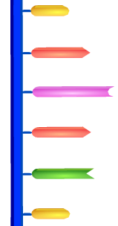
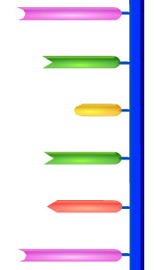
DNA helicase unzips the 2 strands
The enzymes breaks the hydrogen bonds holding the base pairs together.

Slide 9
Free Nucleotides Bind
Complementary base pairing
DNA helicase completes the splitting of the strand.
Meanwhile, free nucleotides that have been activated are attracted to their complementary bases.
Each chain acts as a template.

Slide 10
DNA Polymerase
Once in placed the activated nucleotides are joined together by DNA polymerase.
DNA polymerase joins the new nucleotides to each other by strong covalent bonds, forming the phosphate-sugar backbone.

Slide 11
Replication Finished
The result is that there are two DNA molecules, each with one new synthesised strand of DNA and one strand from the original.
The DNA is then rewound by another enzyme.

Slide 12
A winding enzyme winds the new strands up to form double helices.
DNA helicase unwinds and unzips DNA, breaking the hydrogen bonds that join the base pairs, and forming two separate strands.
DNA polymerase joins the new nucleotides to each other by strong covalent bonds, forming the phosphate-sugar backbone.
Replication starts at a specific sequence on the DNA molecule.
The new DNA is built up from the four nucleotides (A, C, G and T) that are abundant in the nucleoplasm.
The two new molecules are identical to the old molecule.
These nucleotides attach themselves to the bases on the old strands by complementary base pairing. Where there is a T base, only an A nucleotide will bind, and so on.

Slide 13
Steps of Replication
Replication starts at a specific sequence on the DNA molecule.
DNA helicase unwinds and unzips DNA, breaking the hydrogen bonds that join the base pairs, and forming two separate strands.
The new DNA is built up from the four nucleotides (A, C, G and T) that are abundant in the nucleoplasm.
These nucleotides attach themselves to the bases on the old strands by complementary base pairing. Where there is a T base, only an A nucleotide will bind, and so on.
DNA polymerase joins the new nucleotides to each other by strong covalent bonds, forming the phosphate-sugar backbone.
A winding enzyme winds the new strands up to form double helices.
The two new molecules are identical to the old molecule.

Slide 14
http://www.youtube.com/watch?v=bee6PWUgPo8&feature=player_embedded

Slide 15
Explain how the base sequence of DNA is conserved during replication. 5 marks

Slide 16
DNA replication is semi-conservative; DNA is split into two single/template strands; nucleotides are assembled on/attached to each single/template strand; by complementary base pairing; adenine with thymine and cytosine with guanine / A with T and C with G; strand newly formed on each template strand is identical to other template strand; DNA polymerase used; Marks may be awarded for any of the above points if clearly presented in a well-annotated diagram. 5 max

Slide 17
http://www.stolaf.edu/people/giannini/flashanimat/molgenetics/dna-rna2.swf
DNA replication summary

Slide 18
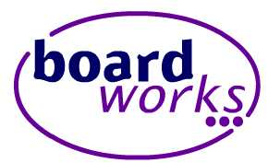
DNA – true or false?

Slide 19
http://www.nobelprize.org/educational/medicine/dna_double_helix/dnahelix.html

Slide 20
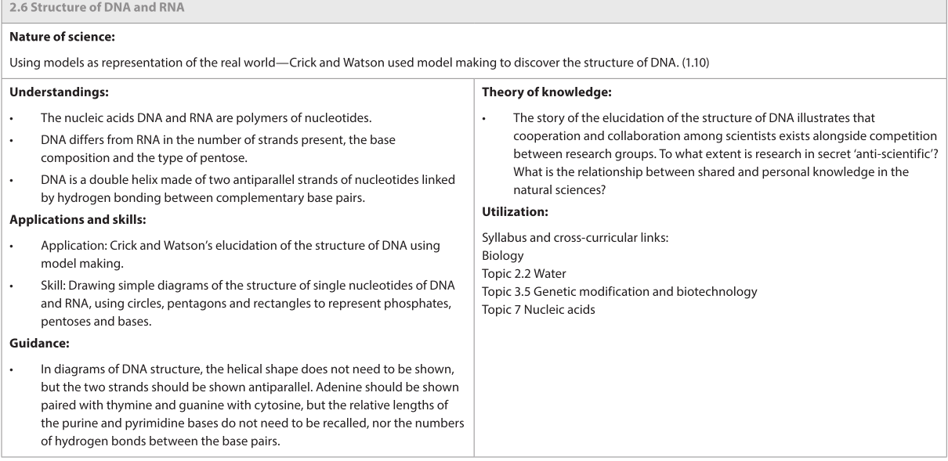

Slide 21
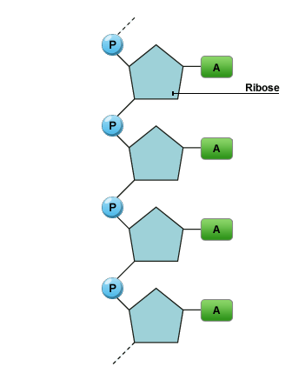
RNA
RNA = ribonucleic acid
RNA is a single -stranded polymer
Each RNA nucleotide consists of:
A pentose sugar (ribose)
A phosphate group
A base – adenine, cytosine, guanine, uracil (instead of thymine)
RNA used in protein synthesis is messenger RNA (mRNA) or transfer RNA (tRNA).

Slide 22
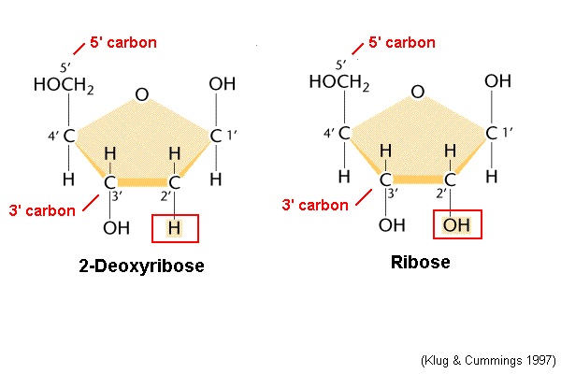
RNA contains the pentose sugar ribose.
DNA contains the pentose sugar deoxyribose.
DNA
RNA

Slide 23
Messenger RNA (mRNA)
mRNA is used to transfer the DNA code from the nucleus to the cytoplasm.
mRNA is complementary to the DNA code.
mRNA is small enough to leave the nuclear pores.
Once in the cytoplasm, mRNA associates with the ribosomes.
mRNA is used to determine the sequence of amino acids during protein synthesis.
mRNA is easily broken down and only exists whilst it is needed to manufacture a protein.
The sequence of nucleotides in the mRNA is referred to as the genetic code.

Slide 24
Transcription (forming mRNA)

Slide 25
Transfer RNA (tRNA)
tRNA is a small molecule (~80 nucleotides).
Single stranded and folded into a clover leaf shape with one end of the chain slightly longer.
This longer section is attached to an amino acid.
Each tRNA can carry a different amino acid.
3 bases at the opposite end of the tRNA are called an anticodon.
Each amino acid has a different anticodon.
The anticodon pairs with the complementary codon on the mRNA.

Slide 26
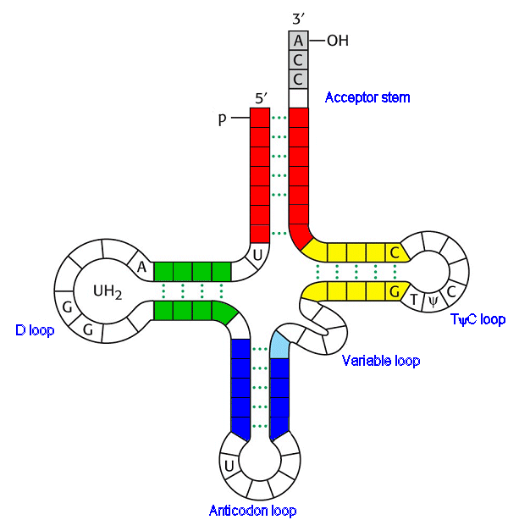
Amino acid joins here
Anticodon

Slide 27
Comparison of DNA, mRNA and tRNA
Feature | DNA | mRNA | tRNA
Double/Single
Size
Shape
Sugar
Bases
Quantity in cells
Stability

Slide 28
Comparison of DNA, mRNA and tRNA
Feature | DNA | mRNA | tRNA
Double/Single | Double | Single | Single
Size | Largest | Variable | Smaller
Shape | Double helix | Single helix | Clover shape
Sugar | Deoxyribose | Ribose | Ribose
Bases | A, G, T, C | A, G, U, C | A, G, U, C
Quantity in cells | Constant (gametes) | Varies | Varies
Stability | Very stable | Unstable | More stable than mRNA, less than DNA

Slide 30
http://education.cambridge.org/uk/whats-new/blog/posts/2014/08/epigenetics-how-dna-methylation-can-change-your-genes
http://www.newscientist.com/article/mg20827853.500-genes-marked-by-stress-make-grandchildren-mentally-ill.html?full=true&print=true#.VG85DGdyY3E

Slide 32
TRANSCRIPTION
The process by which DNA is ‘read’ to produce a strand of mRNA
RNA polymerase
Sense Strand
5’
3’
A G T C G T C A A T G C T A T G C A T T C C G T A C
T C A G C A G T T A C G A T A C G T A A G G C A T G
DNA
3’
Anti-sense Strand
5’
A G U C G U C A A U G C U A U G C A U U C C G U A C
mRNA
5’
3’

Slide 33
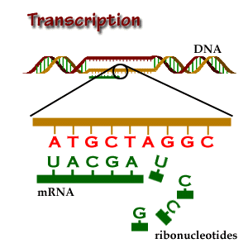
Transcription
Helicase (enzyme) acts on a region of DNA to break the hydrogen bonds between the bases.
RNA polymerase moves along one of the two DNA strands – template strand
RNA polymerase matches up complementary RNA nucleotides.
C matches G and G matches C
U matches A and A matches T
As the RNA nucleotides join together the pre-mRNA is formed.
The DNA behind the RNA polymerase rejoins into a double helix.
When the RNA polymerase reaches a “stop” codon, the chain is terminated and the pre-mRNA detaches.

Slide 34
Animations
http://www.stolaf.edu/people/giannini/flashanimat/molgenetics/transcription.swf
http://www.johnkyrk.com/DNAtranscription.html
http://highered.mcgraw-hill.com/olcweb/cgi/pluginpop.cgi?it=swf::525::530::/sites/dl/free/0072464631/291136/mRNA_synthesis.swf::mRNA_synthesis.swf

Slide 35
Fun fact of the day…
Introns figured prominently in Star Trek: The Next Generation, Season 7, Episode 271, entitled "Genesis."
https://www.youtube.com/watch?v=ork5m37Nhnk
In this episode, a synthetic T-cell inadvertently activated the crewmembers' introns, resulting in de-evolution and the expression of ancient physiological traits

Slide 36
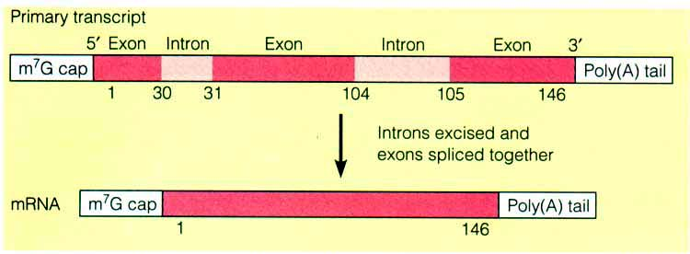
Splicing of mRNA to form mRNA
Once the introns (non-functional DNA) have been removed, the remaining exon sections join together.

Slide 37
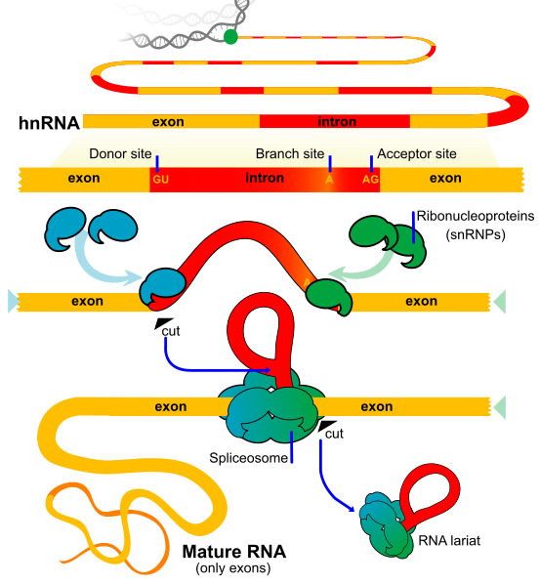
RNA Splicing
Spliceosome
snRNPs

Slide 38
Transcription Animation
mRNA splicing
http://highered.mcgraw-hill.com/olcweb/cgi/pluginpop.cgi?it=swf::525::530::/sites/dl/free/0072464631/291136/spliceosomes.swf::spliceosomes.swf
http://bcs.whfreeman.com/thelifewire/content/chp14/1401s.swf

Slide 39
Polypeptide synthesis – translation You should be able to…
3.5.3 Describe the genetic code in terms of codons composed of triplets of bases.
3.5.4 Explain the process of translation, leading to polypeptide formation.
3.5.5 Discuss the relationship between one gene and one polypeptide.

Slide 40
TRANSLATION
Remember our strand of mRNA from before?
ALA
THR
ILE
ARG
LYS
ALA
SER
VAL
SER
U C A
G C A
G U U
A C G
A U A
C G U
A A G
G C A
U G C
A G U C G U C A A U G C U A U G C A U U C C G U A C G

Slide 41
Synthesising the polypeptide (translation)
mRNA attaches to the ribosome at the “start” codon – AUG.
tRNA with a complementary anticodon attaches to the mRNA – UAC.
This tRNA is attached to an amino acid – methionine
The ribosome moves along the mRNA bringing in 2 tRNA molecules at any one time.
An enzyme and ATP are used to join the amino acids with a peptide bond.
The first tRNA is released and can collect another amino acid.
The process is repeated until a “stop” codon is reached.
Many ribosomes can travel along the mRNA at the same time – polysome.

Slide 42
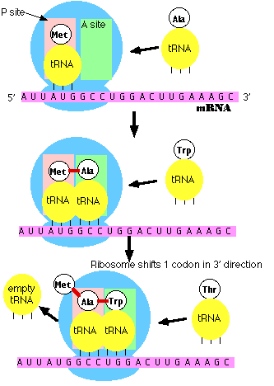

Slide 43
CCCGGATATCCGTATGGAATACTCTCTTCT

Slide 44
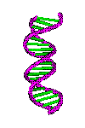
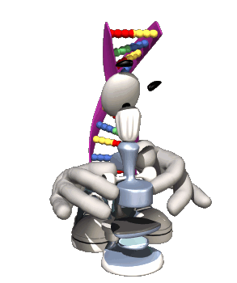
DNA and the Genetic Code
What does the code actually do?

Slide 45
Reminder of DNA Structure
Double-helix shape
Sugar-phosphate backbone
Bases form the ‘rungs’ of the ladder
A, T, C and G
A always pairs opposite T
C always pairs opposite G
© Teachable and Henry Cordy-McKenna. Some rights reserved. http://teachable.net/res.asp?r=3150

Slide 46
DNA Helps Make Proteins
Proteins are complicated molecules made up from many amino acids joined together in a specific sequence
© Teachable and Henry Cordy-McKenna. Some rights reserved. http://teachable.net/res.asp?r=3150

Slide 47
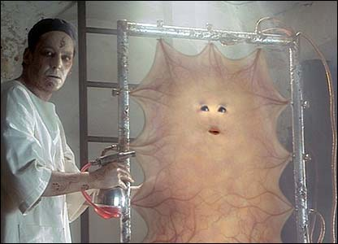
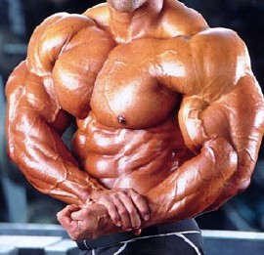
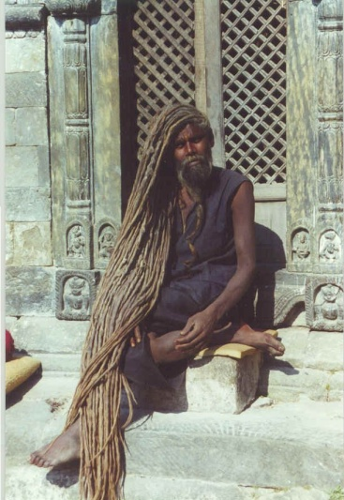
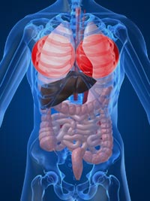
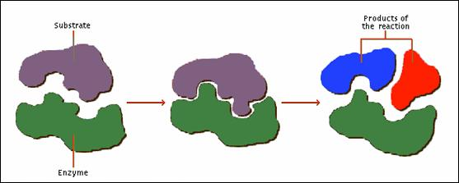
Why do we need Proteins?
Skin
Muscles
Hair
Body organs
Enzymes to speed up reactions inside cells
© Teachable and Henry Cordy-McKenna. Some rights reserved. http://teachable.net/res.asp?r=3150

Slide 48
Base Triplet Codes
One DNA strand is known as the CODING STRAND
The SEQUENCE of the BASES provides the code to make AMINO ACIDS
Three bases code for ONE amino acid
This is called a TRIPLET CODE e.g. ATA GGC CAC CTA TTA GAC
The amino acids join up to make a PROTEIN
© Teachable and Henry Cordy-McKenna. Some rights reserved. http://teachable.net/res.asp?r=3150

Slide 49
© Teachable and Henry Cordy-McKenna. Some rights reserved. http://teachable.net/res.asp?r=3150

Slide 50
Challenge Time!
On the next slide you will see lots of triplet codes
Each triplet codes for an amino acid (one of the molymod balls) or the type of bond needed
I have a DNA code sequence on my desk
Send one person from your team to run up and find the first triplet code, then grab the right amino acid or bond and run back to tag the next person in your team
The first team to join up all the amino acids to make the correct protein is the winner!
© Teachable and Henry Cordy-McKenna. Some rights reserved. http://teachable.net/res.asp?r=3150

Slide 51
Triplet Code | Codes for molymod…
CCC | White amino acid
TCT | Green amino acid
TAT | Red amino acid
ATA | Yellow amino acid
CCG | White amino acid
GGA | Blue amino acid
CTC | Brown amino acid
© Teachable and Henry Cordy-McKenna. Some rights reserved. http://teachable.net/res.asp?r=3150

Slide 52
Decode the Christmas message!

Slide 53
In January 2008, researchers at the J. Craig Venter Institute announced that they had constructed the entire genome of a small bacterium from scratch, thus creating the first example of synthetic life. To distinguish the man-made genome from the natural one, the scientists inserted “watermarks” into the DNA sequence. These sequences were decoded to their one letter amino acid abbreviations and revealed five watermarks commemorating those who had worked on the project: VENTERINSTITVTE, CRAIGVENTER, HAMSMITH, CINDIANDCLYDE, GLASSANDCLYDE

Slide 54
Translation Animation
http://www.johnkyrk.com/DNAtranslation.html
http://highered.mcgraw-hill.com/olcweb/cgi/pluginpop.cgi?it=swf::525::530::/sites/dl/free/0072464631/291136/protein_synthesis.swf::protein_synthesis.swf

Slide 55
Where translation takes place
splicing
AUGC
Single strand of RNA folded into a clover shape
Enzyme that breaks
hydrogen bonds
Making pre-mRNA from a DNA template
tRNA
RNA
Enzyme that joins the free nucleotides together to build mRNA
DNA
Transcription
Removal of non-coding intron
translation
ATGC
DNA helicase
Ribosome
RNA polymerase

Slide 56
splicing
Removal of non-coding intron
translation
Enzyme that breaks
hydrogen bonds
ATGC
DNA helicase
Ribosome
RNA polymerase
Where translation takes place
Enzyme that joins the free nucleotides together to build mRNA
AUGC
Single strand of RNA folded into a clover shape
DNA
Making pre-mRNA from a DNA template
Transcription
tRNA
RNA

Slide 57
You should be able to…
7.4.1 Explain that each tRNA molecule is recognized by a tRNA-activating enzyme that binds a specific amino acid to the tRNA, using ATP for energy.
7.4.2 Outline the structure of ribosomes, including protein and RNA composition, large and small subunits, three tRNA binding sites and mRNA binding sites.
7.4.3 State that translation consists of initiation, elongation, translocation and termination.
7.4.4 State that translation occurs in a direction.
7.4.5 Draw and label a diagram showing the structure of a peptide bond between two amino acids.
7.4.6 Explain the process of translation, including ribosomes, polysomes, start codons and stop codons.
7.4.7 State that free ribosomes synthesize proteins for use primarily within the cell, and that bound ribosomes synthesize proteins primarily for secretion or for lysosomes.

Slide 58
TASK
Create a model of either
TRANSLATION or TRANSCRIPTION
Using plasticine models

Slide 59
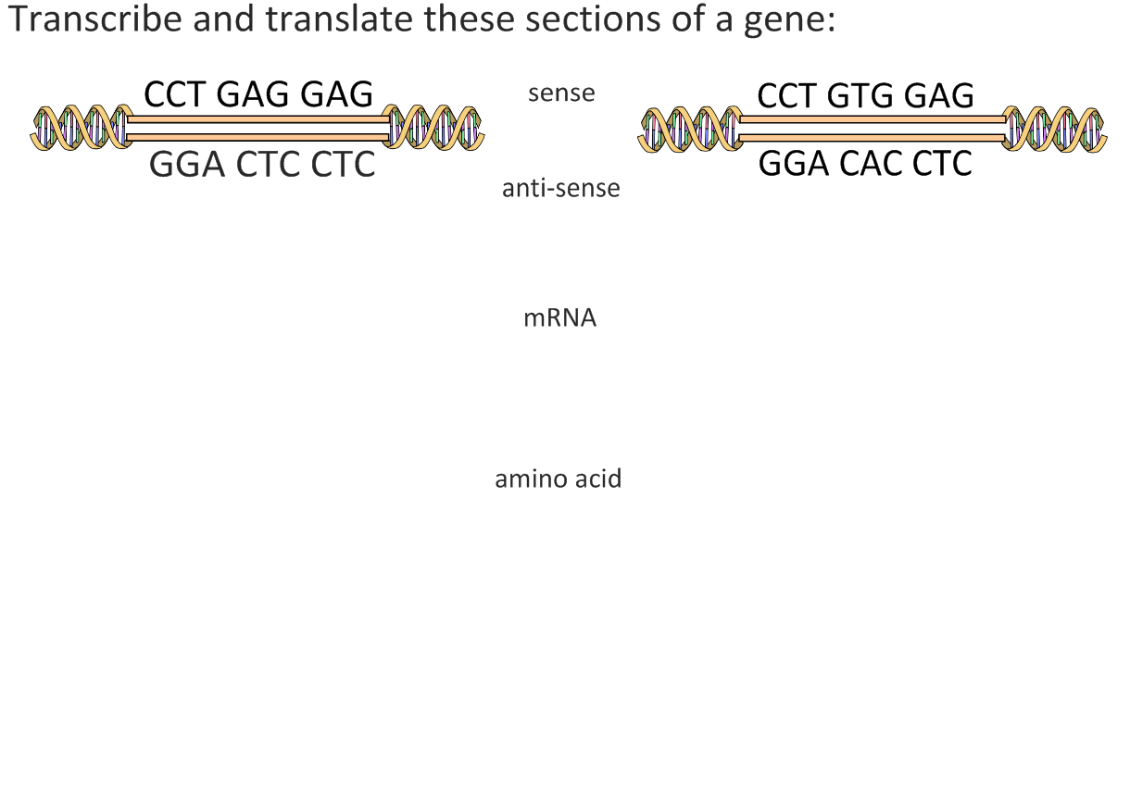

Slide 66
http://www.youtube.com/watch?v=vtW3dMZLrtE&feature=relmfu

