Slide 1
ADAPTATIONS FOR PLANT TRANSPORT

Slide 2
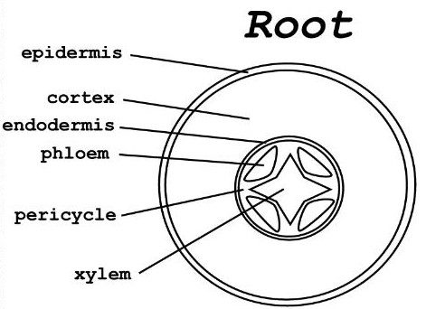
DIAGRAMS OF PARTS OF THE PLANT

Slide 3
XYLEM TISSUE
Form a continuous system for the transport of water and minerals in one direction
They consist of:
dead lignified tracheids
vessels
supporting fibres
living parenchyma
Features of the xylem:
tracheids are hollow and have no end walls
lignin deposited on cellulose cell walls so makes them impermeable
pits in lignified wall for horizontal movement
fibres give strength
parenchyma is packing tissue

Slide 4
PHLOEM TISSUE
Goes in both directions and is involved in translocation which is the transport of sucrose
They consist of:
sieve tubes
companion cells
plasmodesmata with fibres
parenchyma
Features of the phloem
have sieve plates at each end so cytoplasm is continuous between cells
companion cells have organelles and provide ATP for the sieve tube
fibres provide strength and support
parenchyma provides support
plasmodesmata between cells and sieve tube allows transfer of materials between cells

Slide 5
WATER ENTERING THE PLANT
Water enters the root hair down a water potential gradient
the soil has a higher water potential than the root hair
as the water enters the potential is raised above that of the next cell in the root
the water then moves through the root cortex to the xylem down a water potential gradient
There are three ways in which the water can move:
the apoplast pathway through the cell walls
the symplast pathway through the cytoplasm (plasmodesmata)
the vacuolar pathway through the vacuolar
At the endodermis:
the apoplast route is blocked
the casparian strip can be found on the cell wall
it is made of water-proof suberin
this means water cannot pass through
the water passes across the plasma membrane and goes through to the symplast route

Slide 6
TRANSPORT OF MINERAL IONS
Nitrate is taken into the plant through the root hairs
contains nitrogen atoms in a form that plants can use to synthesise amino acids and build up proteins
most of the nitrate is dissolved in the water and passes the apoplast pathway
some enters the symplast pathway by active transport and then flows cell to cell through plasmodesmata
at the endodermis the apoplast pathway is prevented by the casparian strip
ions must pass through the cell membrane of the endodermal cells which allow a measure of selectivity about what passes into the xylem
Root pressure
various ions from the soil are actively transported into the vascular tissues of the roots
water follows and increases the pressure inside the xylem
this positive pressure is called root pressure and can be responsible for pushing up water
can only provide a modest push in the overall process of water transport

Slide 7
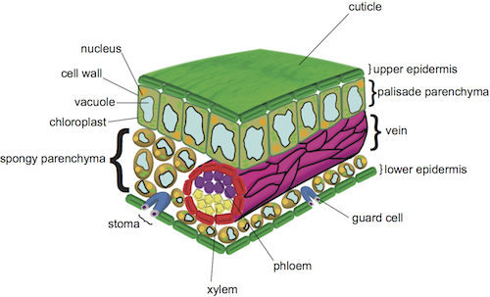
TRANSPIRATION
How it works
water passes through the root to the xylem, the stem and to the leaves where it evaporates
transpiration is the loss of water from the leaves giving rise to the transpiration stream
the continued removal of water from the top of the xylem results in a tension causing a pull on the xylem column
the columns of water in the xylem, are held up by cohesive force between water and adhesive forces between the water and the hydrophilic lining of the xylem
Water movement from the leaves
the opening and closing of the stomata can alter water loss through transpiration
water evaporates from the internal cells of the leaf into air spaces of the mesophyll layer
this area has a high concentration of water vapour, higher than that of the air
water can diffuse to the air through the stomata in the lower epidermis
water moves out of the xylem into the leaf cells down a ψ gradient

Slide 8
TRANSPORT THROUGH THE XYLEM
The cohesion tension theory
there’s a higher concentration of water in the cell walls of the leaf than in the air outside
water evaporates in the spaces between the cells and out of the plant (transpiration)
as water evaporates the concentration of solutes inside the leaf cells increase and draws in water from the xylem to replace that which has been lost through osmosis
the water molecules in the xylem have a force of attraction to each other called cohesion
as water molecules leave the xylem they pull other water molecules up the xylem
as a result the removal of water at the top of the plants pull a continuous column up
the cohesive forces and the adhesive forces between the water molecules and the hydrophilic lined xylem wall prevents the column from breaking
as a consequence of the pulling of water upwards, the column is stretched and under tension

Slide 9
FACTORS THAT AFFECT TRANSPIRATION
External factors that can affect the transpiration rate:
light – controls the stomata to open in order to allow gas exchange for photosynthesis and causes water loss
temperature – if conditions are warmer the molecules have more kinetic energy to cause faster diffusion to take place
humidity – when humidity is higher the diffusion gradient is slower and means slower transpiration takes place
air movement – the more there is, the faster transpiration is as the diffusion gradient is maintained by the removal of water vapour from the plant surface
Transpiration can be measured using a potometer
as water is lost from the leaves it’s drawn up the
capillary tube with the air bubble
the distance the bubble travels is measured to
examine how external factors affect it

Slide 10
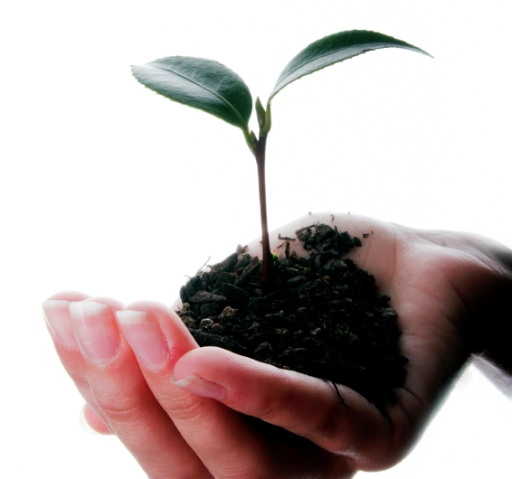
PLANT ADAPTATIONS TO WATER
Mesophytes
plants from habitats with adequate water supply
do not have special adaptations
shed leaves in autumn (deciduous)
have waxy cuticles or sunken stomata
hairy leaves
examples are oak and privet
Hydrophytes
lives with roots submerged in mud and floating leaves
stomata is at the top of the leaf
air spaces are very large
example is a water lily
Xerophytes
live where water availability is low (arid)
the leaves roll up due to hinge cells
stomata is shrunken
a thick waxy cuticle on lower epidermis
hair like extensions called trichomes

Slide 11
TRANSLOCATION
This is the transport of food and organic substances
the products of photosynthesis are transported in soluble form to all part of the plant in the phloem
they are converted to sucrose and transported around the plant to where it’s needed
the leaves are a source of sugars and the growing tissues are a sink
radioactive tracing and using aphid mouthparts demonstrates that it’s a rapid process
radioisotope labelling and autoradiography shows sucrose is transported bi-directionally to sinks
mass flow suggests there’s a passive flow of sucrose from source to sink
mass flow does not account for all observation such as the movement in opposite directions at the same time and at different rates
other hypotheses have been proposed such as diffusion and cytoplasmic streaming

Slide 12
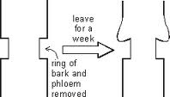
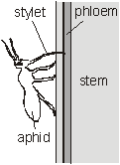
EXPERIMENTAL EVIDENCE THAT PHLOEM TRANSPORTS SUGARS
Ringing experiments
the phloem vessels are outside the xylem vessels and can be selectively removed by cutting a ring in the stem
after a week there is swelling above the ring and reduced growth below the ring while the leaves were unaffected
early evidence sugars were transported downwards in the phloem
Aphid stylets
have specialised mouthparts called stylets that can penetrate phloem tubes and consume the sugary sap therein
if aphids are anaesthetised with CO2 then cut off, the stylet remains in the phloem
phloem sap can be collected through it for analysis
this is more accurate than a syringe
the aphid’s enzymes ensure that the stylet doesn’t get blocked

Slide 13
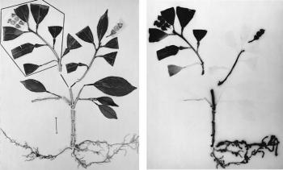
EXPERIMENTAL EVIDENCE THAT PHLOEM TRANSPORTS SUGARS
Autoradiography
can be used to trace where compounds are being transported to and from and measure the rate of transport using photographic film (an autoradiograph)
a plant is grown and one leaf is exposed for a short time to CO2 contained radioactive isotope 14C
it will be taken up by photosynthesis and the 14C incorporated into glucose and then sucrose
plant is frozen in liquid nitrogen to kill and fix it quickly and placed onto photographic film in the dark
the resulting autoradiograph shows the location of compounds contain 14C
experiment shows organic compounds are transported from leaf to the roots
The darker areas show where the ¹⁴C containing compounds are. They have been transported to the root and to the growing point on the right. These areas are where the organic molecules are used.
¹⁴CO₂ is applied to the leaves in the boxed area. This is used in photosynthesis to manufacture organic molecules which contain ¹⁴CO₂.

Slide 14
THE MASS FLOW HYPOTHESIS
How it works:
photosynthesis produces organic molecules including sucrose in the leaves these are termed the source
sucrose is loaded by active transport into sieve tubes using ATP
water enters the sieve tube along a ψ gradient by osmosis
the pressure into the sieve tubes increases and the sucrose moves through the phloem to the sinks where the sucrose is being used
sucrose is unloaded by active transport into cells at the sink where it’s used for respiration to provide ATP for growth or is converted to starch for storage
sinks can be roots or growing shoots
water move by osmosis out the phloem as the sucrose is removed and the pressure in the phloem is lower at the sink
there is a pressure difference between source and sink that maintains the movement through the phloem
however this does not account for all things like the movement in opposite directions, cytoplasmic continuity, mitochondria and sieve plates

Slide 15
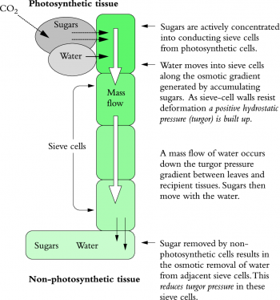
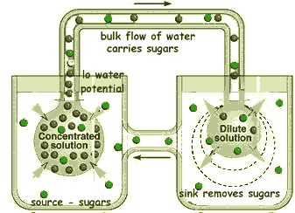
THE MASS FLOW HYPOTHESIS

