Slide 1
Chloroplasts
16/10/2013
Starter
What does a chloroplast do?
What features do you think a chloroplast needs to effectively do it’s job?

Slide 2
Objectives
(a) The distribution of chloroplasts in relation to light trapping.
Chloroplasts as transducers converting the energy of light photons into the chemical energy of ATP.
Light harvesting. Absorption of various wavelengths of light by chlorophyll and associated pigments and energy transfer to reaction centres.

Slide 3
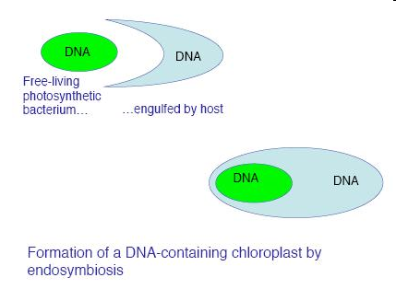
Evolution of the chloroplast
It is believed that photosynthetic bacteria were acquired by eukaryotic cells
By endocytosis (engulfing)
To produce the first algal/plant cell
This is called the “endosymbiont theory”
They were then passed on to the next generation

Slide 4
Current organisms trying endosymbiosis to get chloroplasts
Two types of marine molluscs currently engulf algae and incorporate their chloroplasts to allow them to make complex molecules
However, they have not yet found a way of passing these to the next generation

Slide 5
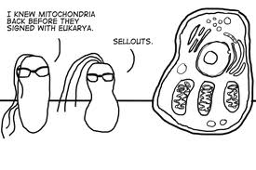
http://www.youtube.com/watch?v=5T3U51yzdEg
Sea slugs

Slide 6
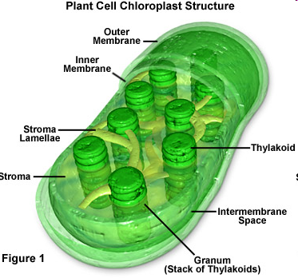
Chloroplast structure

Slide 7
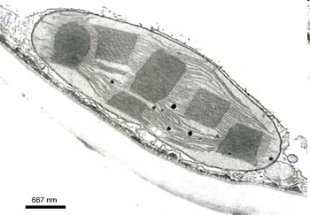
Size and Shape
Can vary
Usually between 2-10µm in length
Usually disc shaped

Slide 8
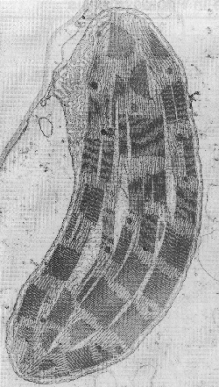
Electron micrograph

Slide 9
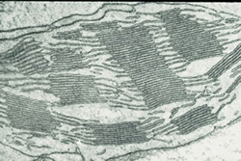

Slide 10
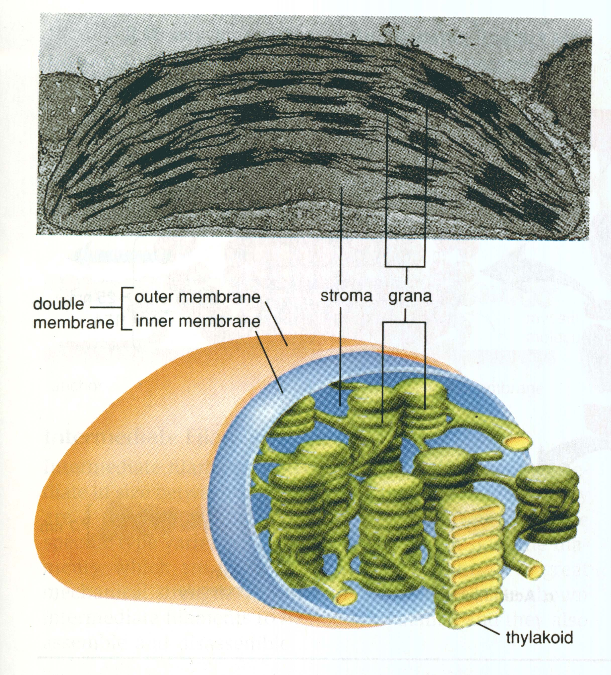

Slide 11
Membranes
Double (phospholipid) membrane;
Outer membrane – permeable to many small ions
Inner membrane – less permeable and has transport proteins embedded in it
Intermembrane space is 10–20nm wide between the inner and outer membrane

Slide 12
Lamellae and thylakoids
The inner membrane is folded into lamellae (thin plates) aka thylakoids
The lamellae (thylakoids) are stacked in piles called granum
Between the grana are intergranal lamellae

Slide 13
Stroma
Fluid-filled matrix
The light-independent stage of photosynthesis occurs here
Contains starch grains, oil droplets, DNA and ribosomes

Slide 14
Grana
Contains stacks of thylakoids
Where the light-dependant stage of photosynthesis takes place
Absorb light and make ATP

Slide 15
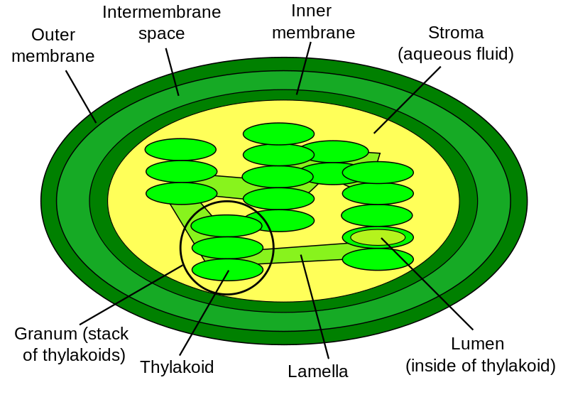
Diagram labelling quick-draw
B
C
A
D
E
H
F
G

Slide 16
Diagram labelling quick-draw

Slide 17
Photosynthetic pigments
Absorb certain wavelengths of light
Reflect other wavelengths (these are the colours we see)
Arranged in photosystems in thylakoid membranes

Slide 19
Chlorophylls
Chlorophyll a
Is in the “Primary pigment reaction centre”
Two forms
P₆₈₀ – in photosystem 2
P₇₀₀ – in photosystem 1
Appears yellow-green
Absorbs red light (and blue at 450nm)
contains a Mg atom – when light hits this, a pair of electrons become excited

Slide 20
Accessory pigments
Chlorophyll b
Absorbs light at wavelengths between 500-640nm
It appears blue-green
Is one of the accessory pigments
Carotenoids
Absorb blue light
Reflects yellow (xanthophyll) and orange (carotene) light
They absorb light not normally absorb by chlorophylls – then pass

Slide 21
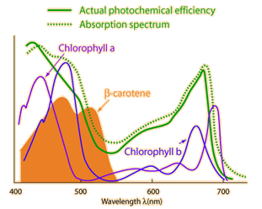

Slide 22
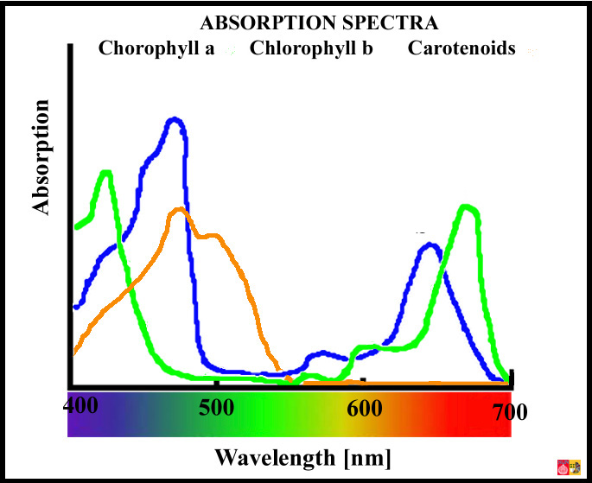

Slide 23
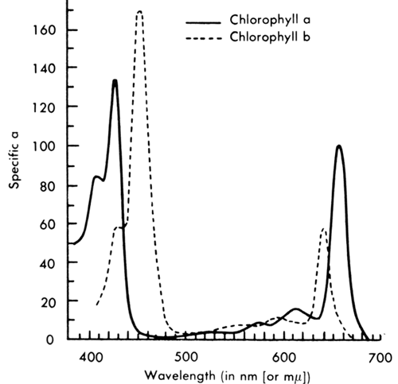

Slide 24
Separation of Chlorophyll Pigments by Paper Chromatography
Immerse a few spinach leaves in boiling water. Remove and dry.
Grind up the leaves in a pestle and mortar with a small quantity of pure acetone.
Draw a pencil line 30mm from one end of the chromatography paper and use a capillary tube to put a drop of the chlorophyll solution on the centre of the line (do this carefully).
Allow this to dry (try placing it near a heat source e.g. lamp, or using a fan).
Add a second drop on top of the first, again let it dry. Then repeat this for at least 15 minutes (20 is better). The smaller and more concentrated the spot the better.
Pour approximately 20mm of chromatography solvent (solvent 2 – acetone and petroleum ether) into a boiling tube and suspend the chromatography paper into it, so that the bottom is immersed (but the pencil line is not).
The solvent will ascend rapidly and the pigments should separate in 10 minutes. When the solvent front is approximately 20mm from the top remove the paper and draw a line to show the solvent front and dry the paper.

Slide 25
Objectives
(a) The distribution of chloroplasts in relation to light trapping.
Chloroplasts as transducers converting the energy of light photons into the chemical energy of ATP.
Light harvesting. Absorption of various wavelengths of light by chlorophyll and associated pigments and energy transfer to reaction centres.

Slide 27
Echalk bouncing ph.syn. quiz

Slide 28
Oxidation and reduction – always take place together
Oxidation
Reduction
Addition of oxygen
Loss of electrons
Loss of hydrogen
Energy given out
Loss of oxygen
Gains electrons
Gains hydrogen
Energy taken in

Slide 29
Objectives You should be able to…
(b) Basic features of Photosystems I and II.
Cyclic and non-cyclic photophosphorylation sources of electrons for the electron transport chain. Photolysis as a source of electrons for Photosystem II. Reduction of NADP by addition of electrons and hydrogen ions; occurs in the stroma maintaining the proton gradient.

Slide 31
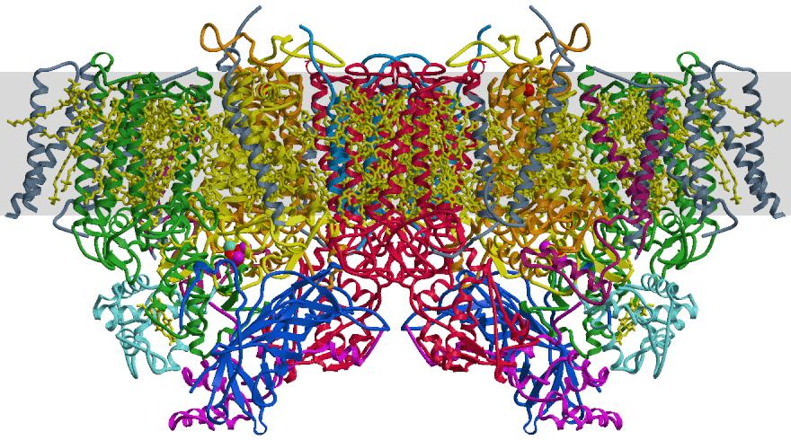

Slide 32
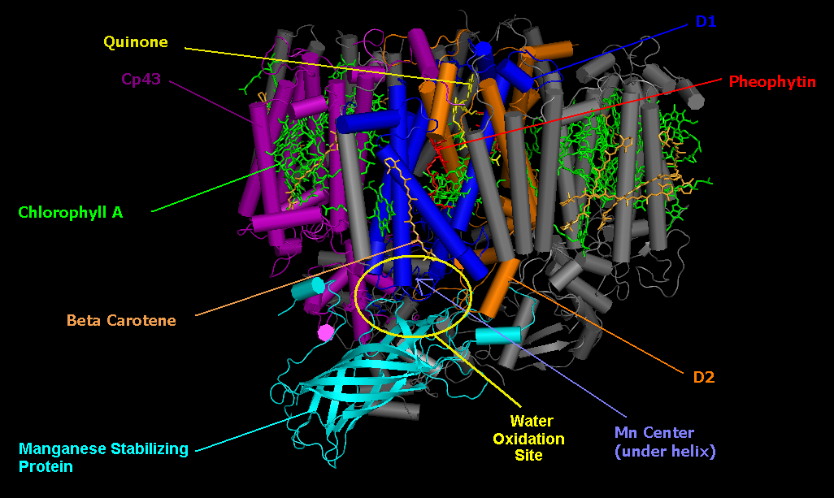

Slide 33
Pigments and photosystems
Chloroplasts contain photosynthetic pigments to absorb the light energy
Pigments are chlorophyll a, chlorophyll b and carotene
The pigments are found in the thylakoid membranes attached to proteins.
The protein and pigment are called a photosystem
Two photosystems used by plants to absorb light are PSI ( 700nm wavelength) and PSII ( 680nm wavelength)

Slide 34
Photosynthesis
Photosynthesis can be split into two stages
The light-dependent reaction
The light-independent reaction – AKA the Calvin Cycle

Slide 35
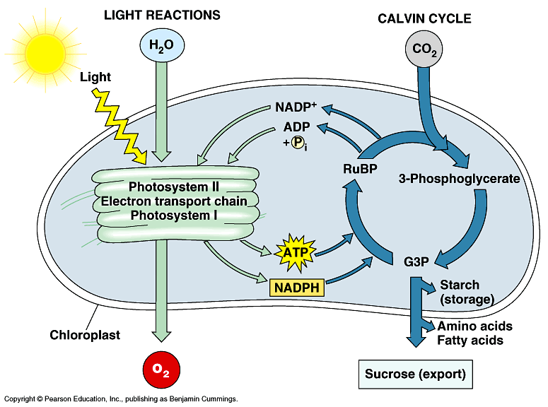

Slide 36
Light dependent reaction
This reaction needs light energy
Takes place in the thylakoid membranes
Light energy absorbed by photosynthetic pigments in the photosystems and converted to chemical energy
Light energy is used to add inorganic phosphate to ADP to form ATP
And reduce NADP to form reduced NADP
ATP transfers energy and reduced NADP transfers hydrogen to the light independent reaction
During the process H₂O is oxidised to O₂

Slide 37
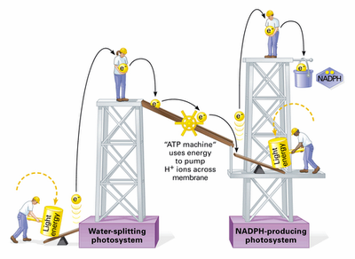
Analogy

Slide 38
Photosynthesis Animations

Slide 39
Photophosphorylation and photolysis
In the light-dependent reaction, the light energy absorbed by the photosystems is used for three things:
Making ATP from ADP and P_{i} – this is known as photophosphorylation
Making reduced NADP from NADP
Splitting water into protons( H⁺ ions), electrons and oxygen. This is called photolysis

Slide 40
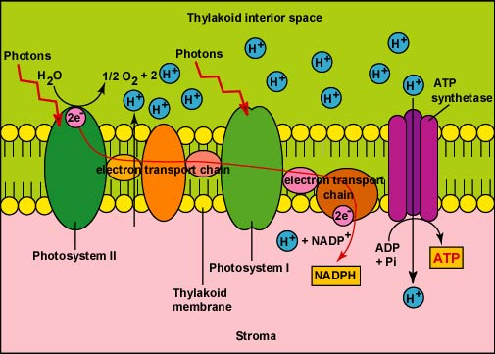
Light-dependent reaction

Slide 41
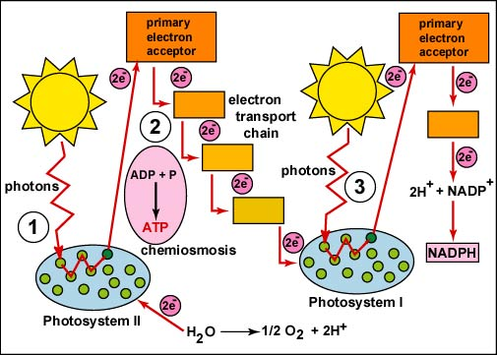
1

Slide 42
Non-cyclic photophosphorylation
Produces ATP, reduced NADP and O₂
Photosystems in the thylakoid membranes are linked by electron carriers
Electron carriers are proteins that transfer electrons
The photosystems and their electron carriers form an electron transport chain – a chain of proteins through which excited electrons flow

Slide 43
Light energy excites electrons in chlorophyll
Light energy is absorbed by PSII
Light energy excites electrons in chlorophyll
The electrons move to a higher energy level
These high energy electrons move along the electron transport chain to PSI

Slide 44
Photolysis of water produces protons ( H⁺ ions), electrons and O₂
As the excited electrons from chlorophyll leave PSII to move along the electron transport chain, they must be replaced
Light energy splits water into protons (H^{+ ions}), electrons and oxygen
H₂O 2H⁺ + 1/2 O₂

Slide 45
Energy from the excited electrons makes ATP
The excited electrons lose energy as they move along the electron transport chain
This energy is used to transport protons into the thylakoid so that the thylakoid has a higher concentration of protons than the stroma. This forms a proton gradient across the membrane
Protons move down their concentration gradient, into the stroma, via an enzyme ATP synthase. The energy from this movement combines ADP and P_{i} to form ATP
Chemiosmosis is the name of the process where the movement of H⁺ ions across a membrane generates ATP – this also occurs in respiration

Slide 46
Generation of reduced NADP
Light energy is absorbed by PSI, which excites the electrons again to an even higher energy level
Finally, the electrons are transferred to NADP, along with a proton (H⁺ ion) from the stroma, to form reduced NADP

Slide 47
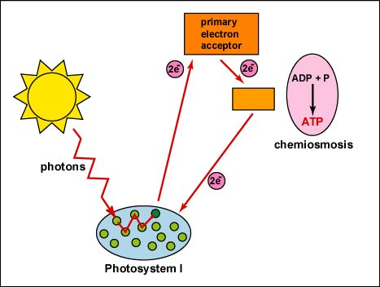
Cyclic photophosphorylation
Only uses PSI
Cyclic because the electrons used aren’t passed to NADP, but passed back to PSI via electron carriers
Electrons recycled and used repeatedly to flow through PSI
Produces small amounts of ATP

Slide 48
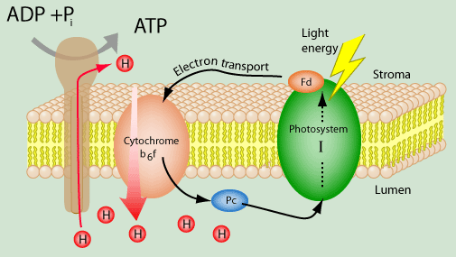
Cyclic photophosphorylation

